Slide 1



LI Detector: Measuring Small Fitness Effects in High Throughput
Saurin Parikh
Carvunis Lab
Department of Computational and Systems Biology
Pittsburgh Center for Evolutionary Biology and Medicine
University of Pittsburgh School of Medicine
Notes:
Good afternoon everyone!
My name is Saurin, I am a 2nd year PhD student in the Carvunis Lab
And today I am going to talk to you about a method that I have developed, the LI Detector, that can be used for measuring small fitness effects in high throughput

Slide 2
Overview
Background
Colony based high-throughput screens (CBHTS)
Problem of spatial bias in CBHTS
How does LI Detector address this issue?
Notes:
Overall I will quickly go through some background about my project and why I am interested in colony-based high-throughput screens
Then introduce the problem of spatial bias in these screen and finally describe how I am addressing it using the LI Detector
Ok so let's jump right into it…

Slide 3

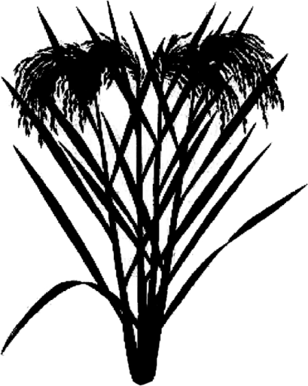
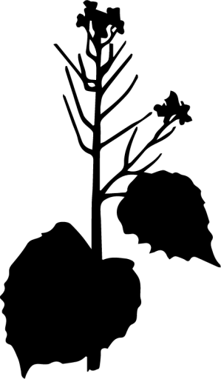



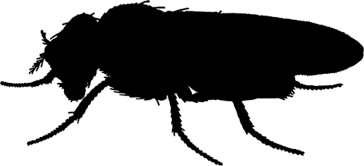

Where do novel genes come from?
de novo gene birth
Noncoding Sequence
Gene
Saccharomyces Oryza Brassicaceae Arabidopsis Drosophila Mus Pan Homo
*inspired from Van Oss et al. 2019
* Van Oss et al. 2019
Notes:
The emergence of new genes has been largely attributed to the re-organization of existing genetic material, by process like gene duplication, gene fusion/fission, horizontal gene transfer, etc…
The possibility of genes arising de novo from previously non-genic regions has been considered extremely unlikely
However, genomes of all sequenced organisms contain genes that share no detectable homology to genes in other species

Slide 4
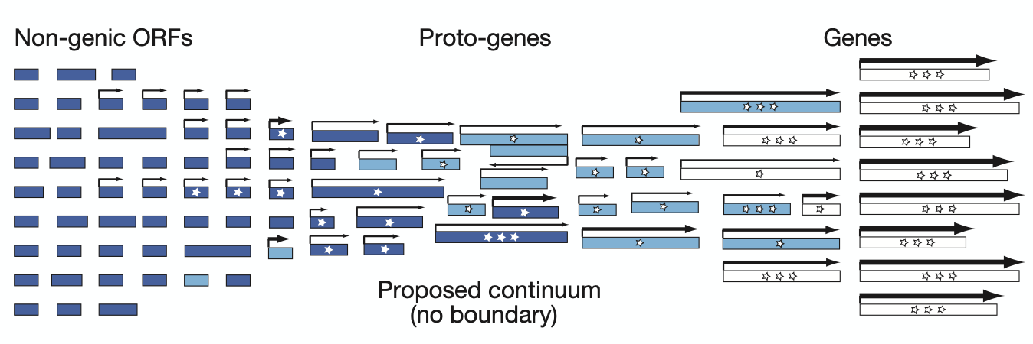
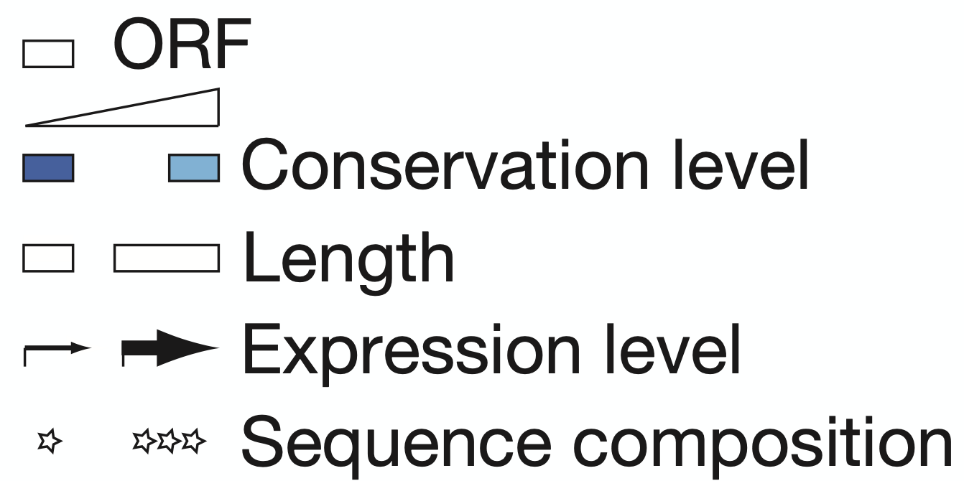
Proto-gene model of de novo gene birth
*Carvunis et al. 2012
Notes:
The Proto-gene model of de novo gene birth provides one possible mechanism through which these genes might have arisen
This model formalizes an evolutionary continuum from non-genic sequences to proto-genes to genes.
Where non-genic ORFs acquire expression potential, increase in length, conservation and sequence maturity, in no particular order to finally become genes
Sequence composition refers to codon usage, amino acid abundances and structural features

Slide 5
Proto-genes and yeast!
There are 1891 proto-genes in S. cerevisiae genome (Carvunis et al. 2012)
I want to characterize the phenotypic impact of these proto-genes!
S. cerevisiae
Overexpression
Adaptive
Deletion
Deleterious
Notes:
Proto-genes were first identified in the S. cerevisiae genome in 2012 and there were 1891 of them at that time!
What I want to do during my PhD is to characterize the phenotypic impact of these proto-genes
Especially by figuring out if their over-expression or deletion is either adaptive or deleterious to the organism under certain conditions, I wish to shed light on their potential functionality
But since I can not individually characterize all of them one-at-a-time, I wish to adopt colony based high throughput technology to assist me through this…

Slide 6
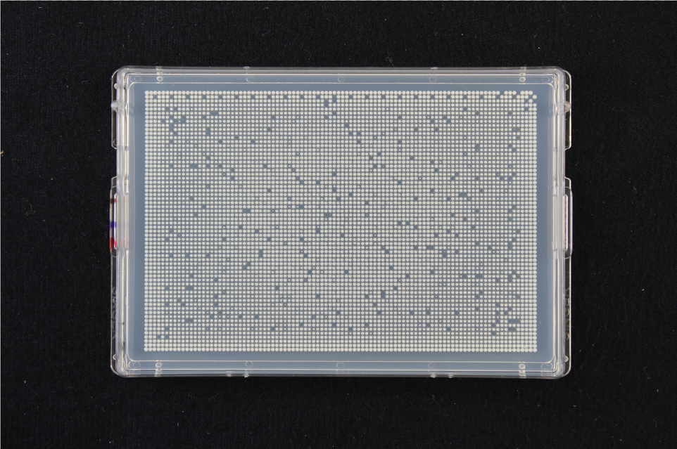
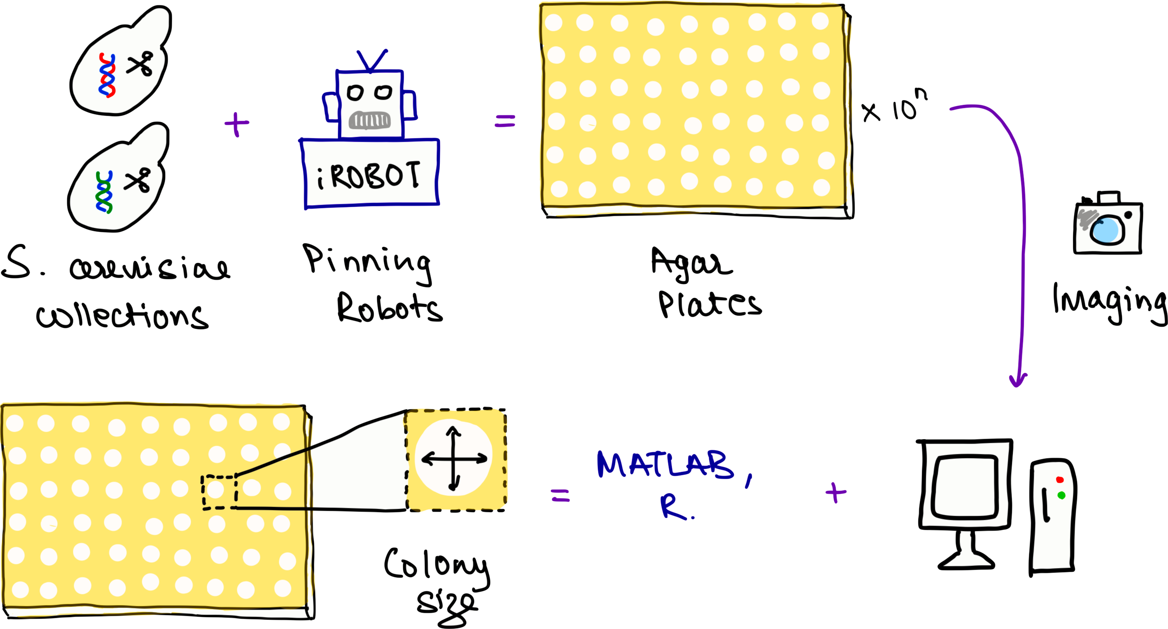
Colony-based high-throughput screens (CBHTS)
Notes:
Colony-based high-throughput screens have become increasingly popular thanks to the availability of microbial model organism mutant collections and robotic equipment's that help facilitate quicker and larger screens.
A typical experiment generates multiple agar plates, like the one in the background, which are used to record growth using imagery that is then analyzed to result in a quantitative output of colony size as a proxy for fitness of different mutants.

Slide 7

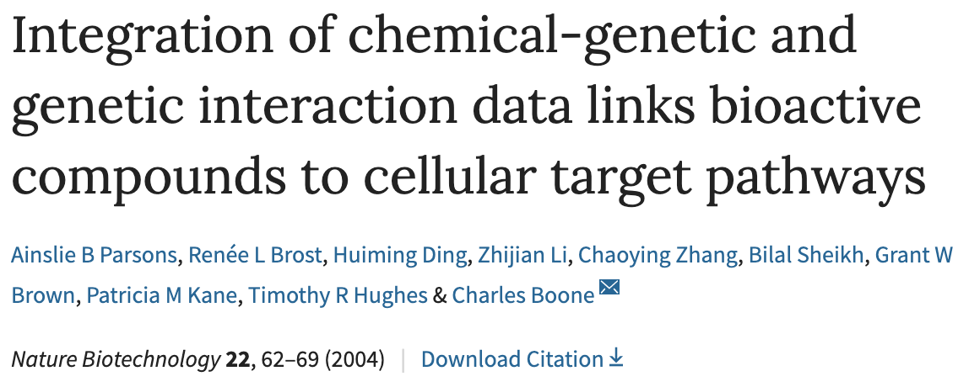
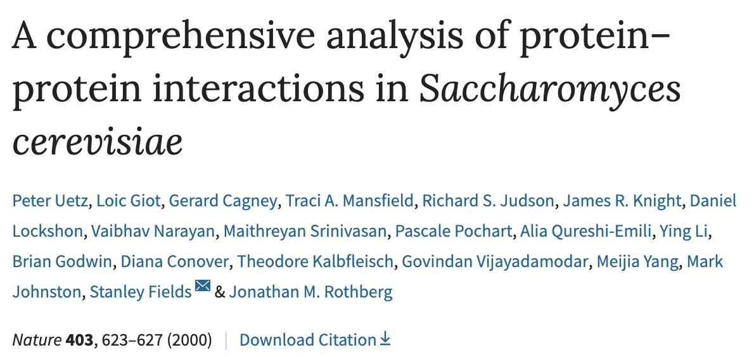
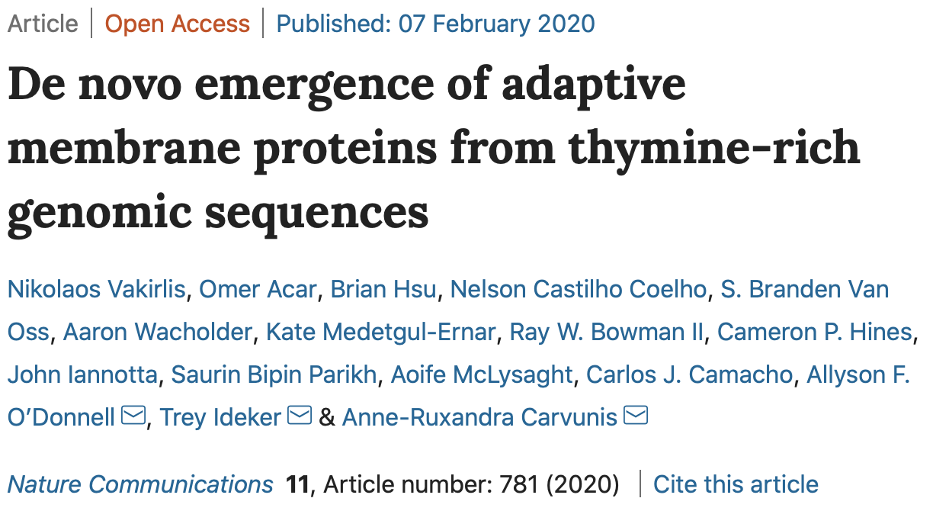
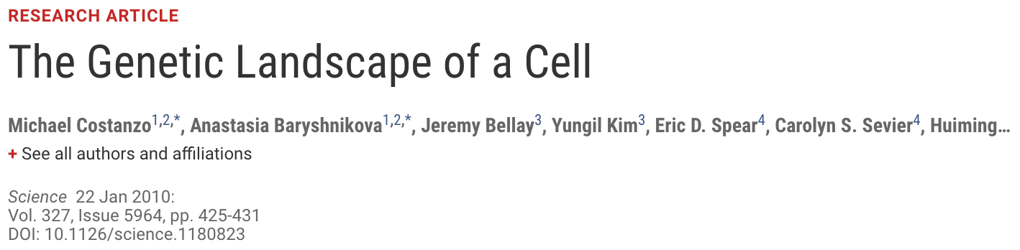
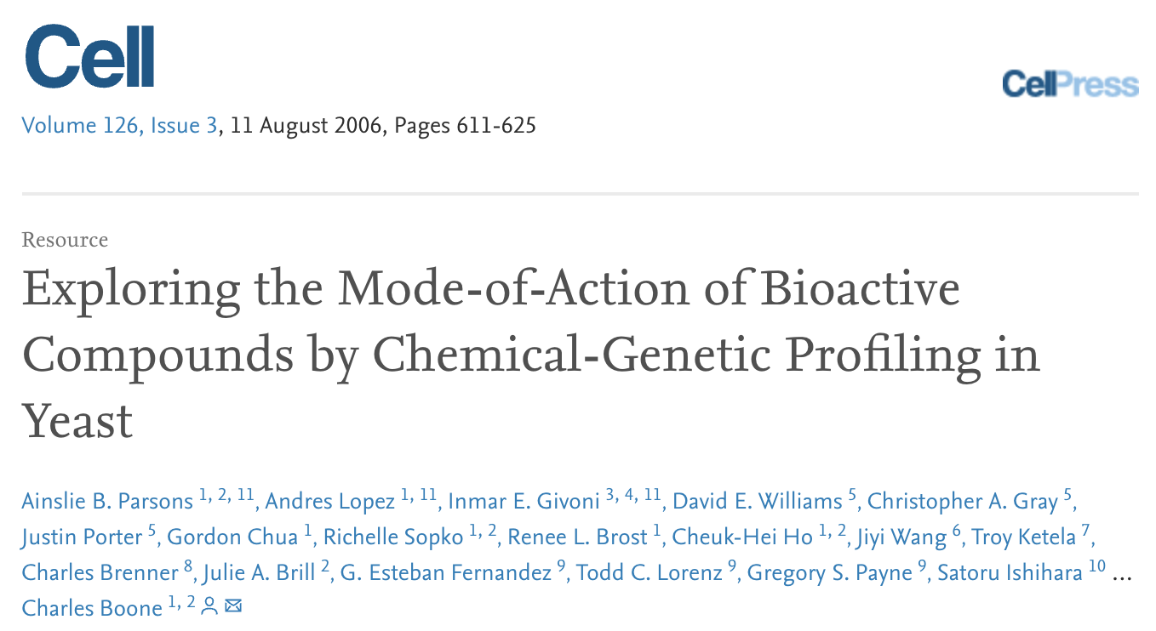
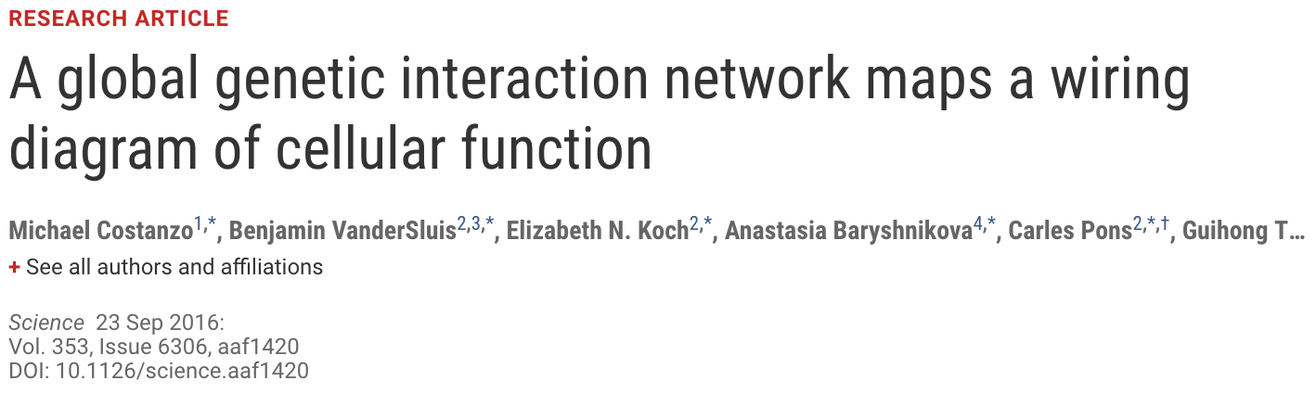
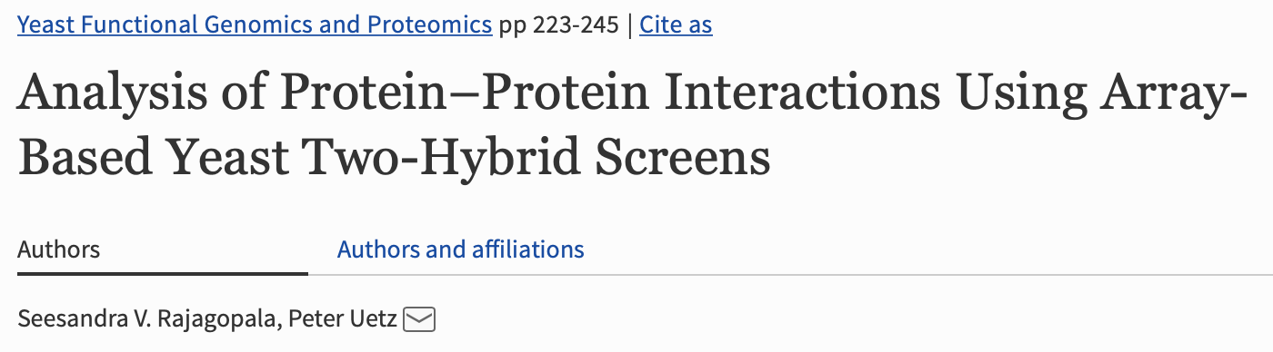
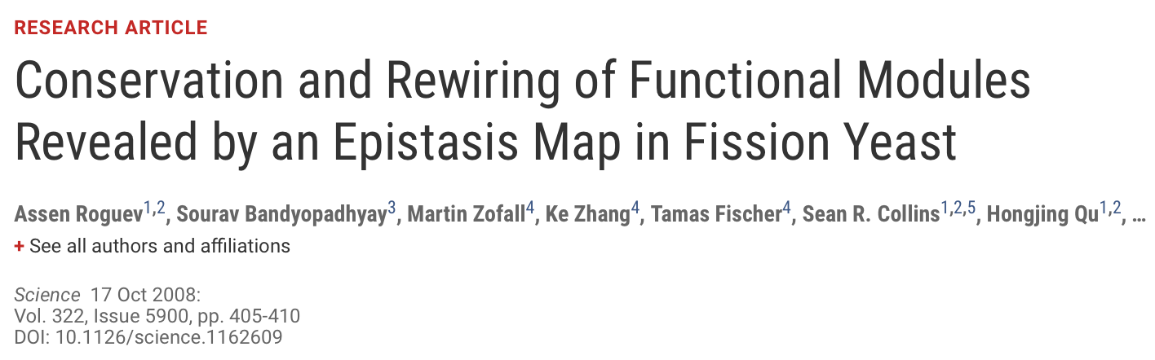
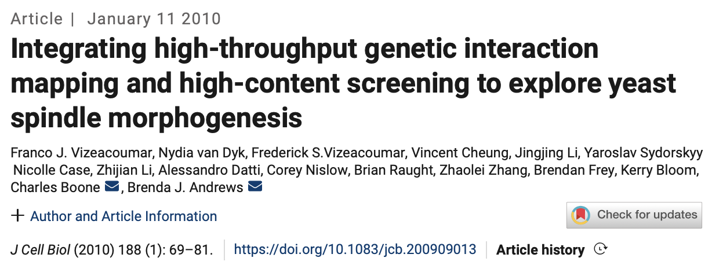
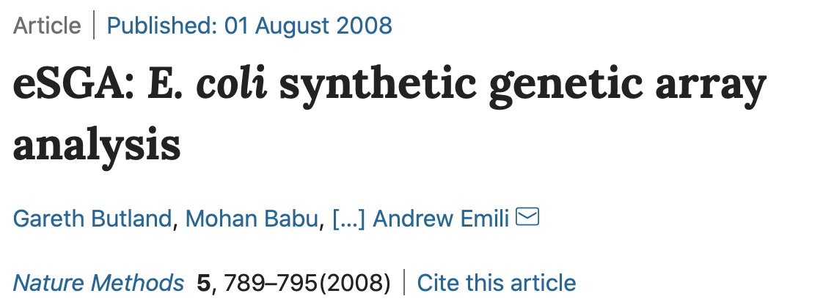
CBHTS have been widely used
Notes:
Colony based high-throughput screens have been used to identify gene-gene, gene-environment, protein-protein interactions, and even for questions of basic biology.
Most recently they were used in a paper on evolutionary biology coming out of our and Allyson's lab, which also had significant inputs from the Pittsburgh Area Yeast community

Slide 8
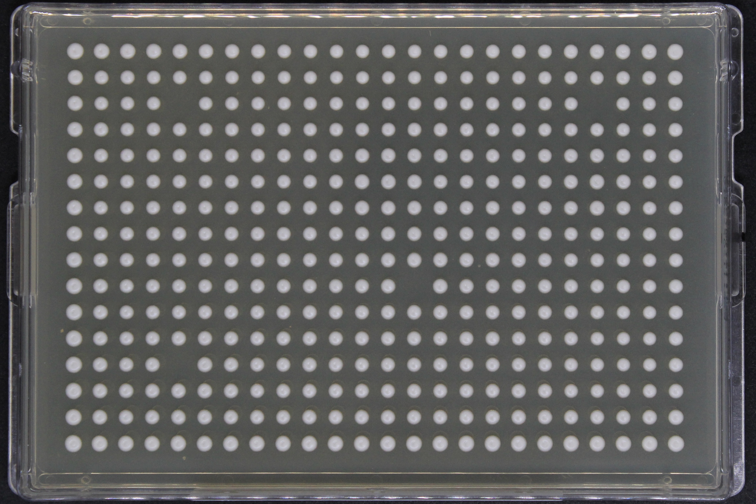
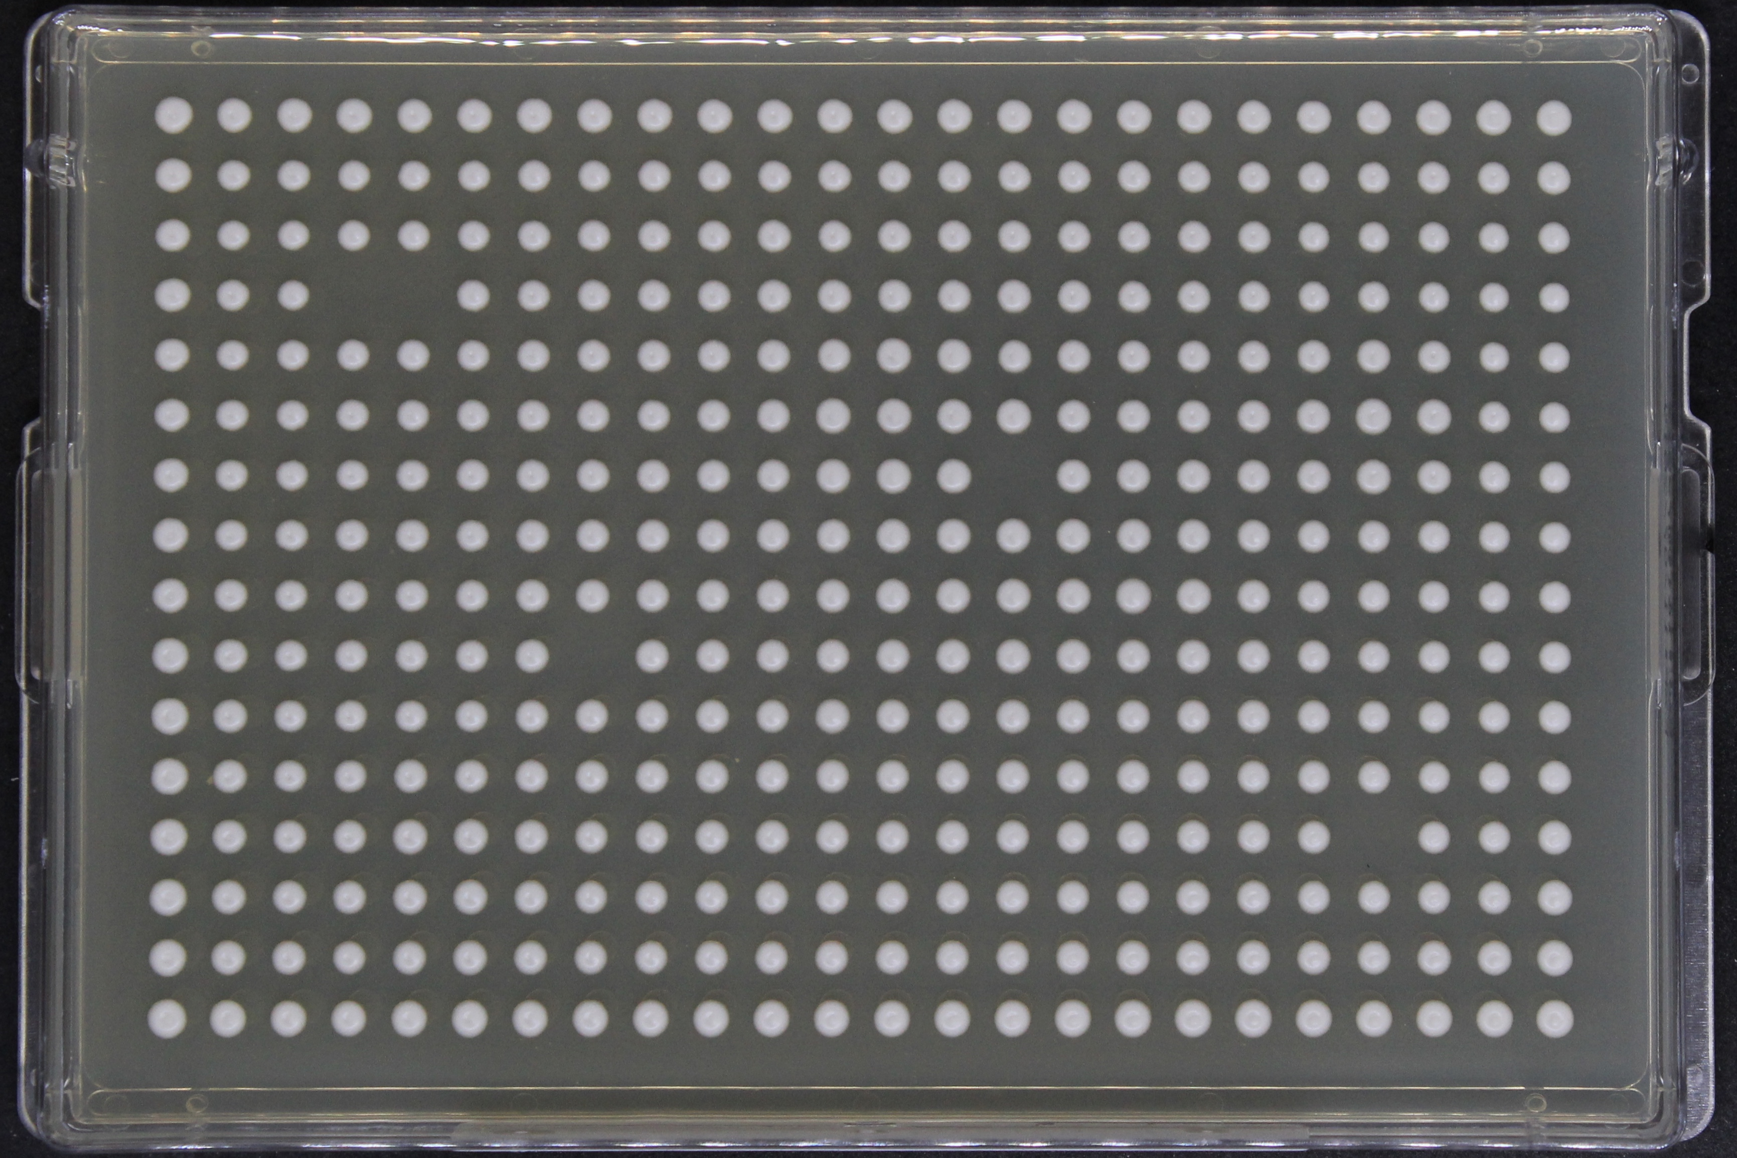
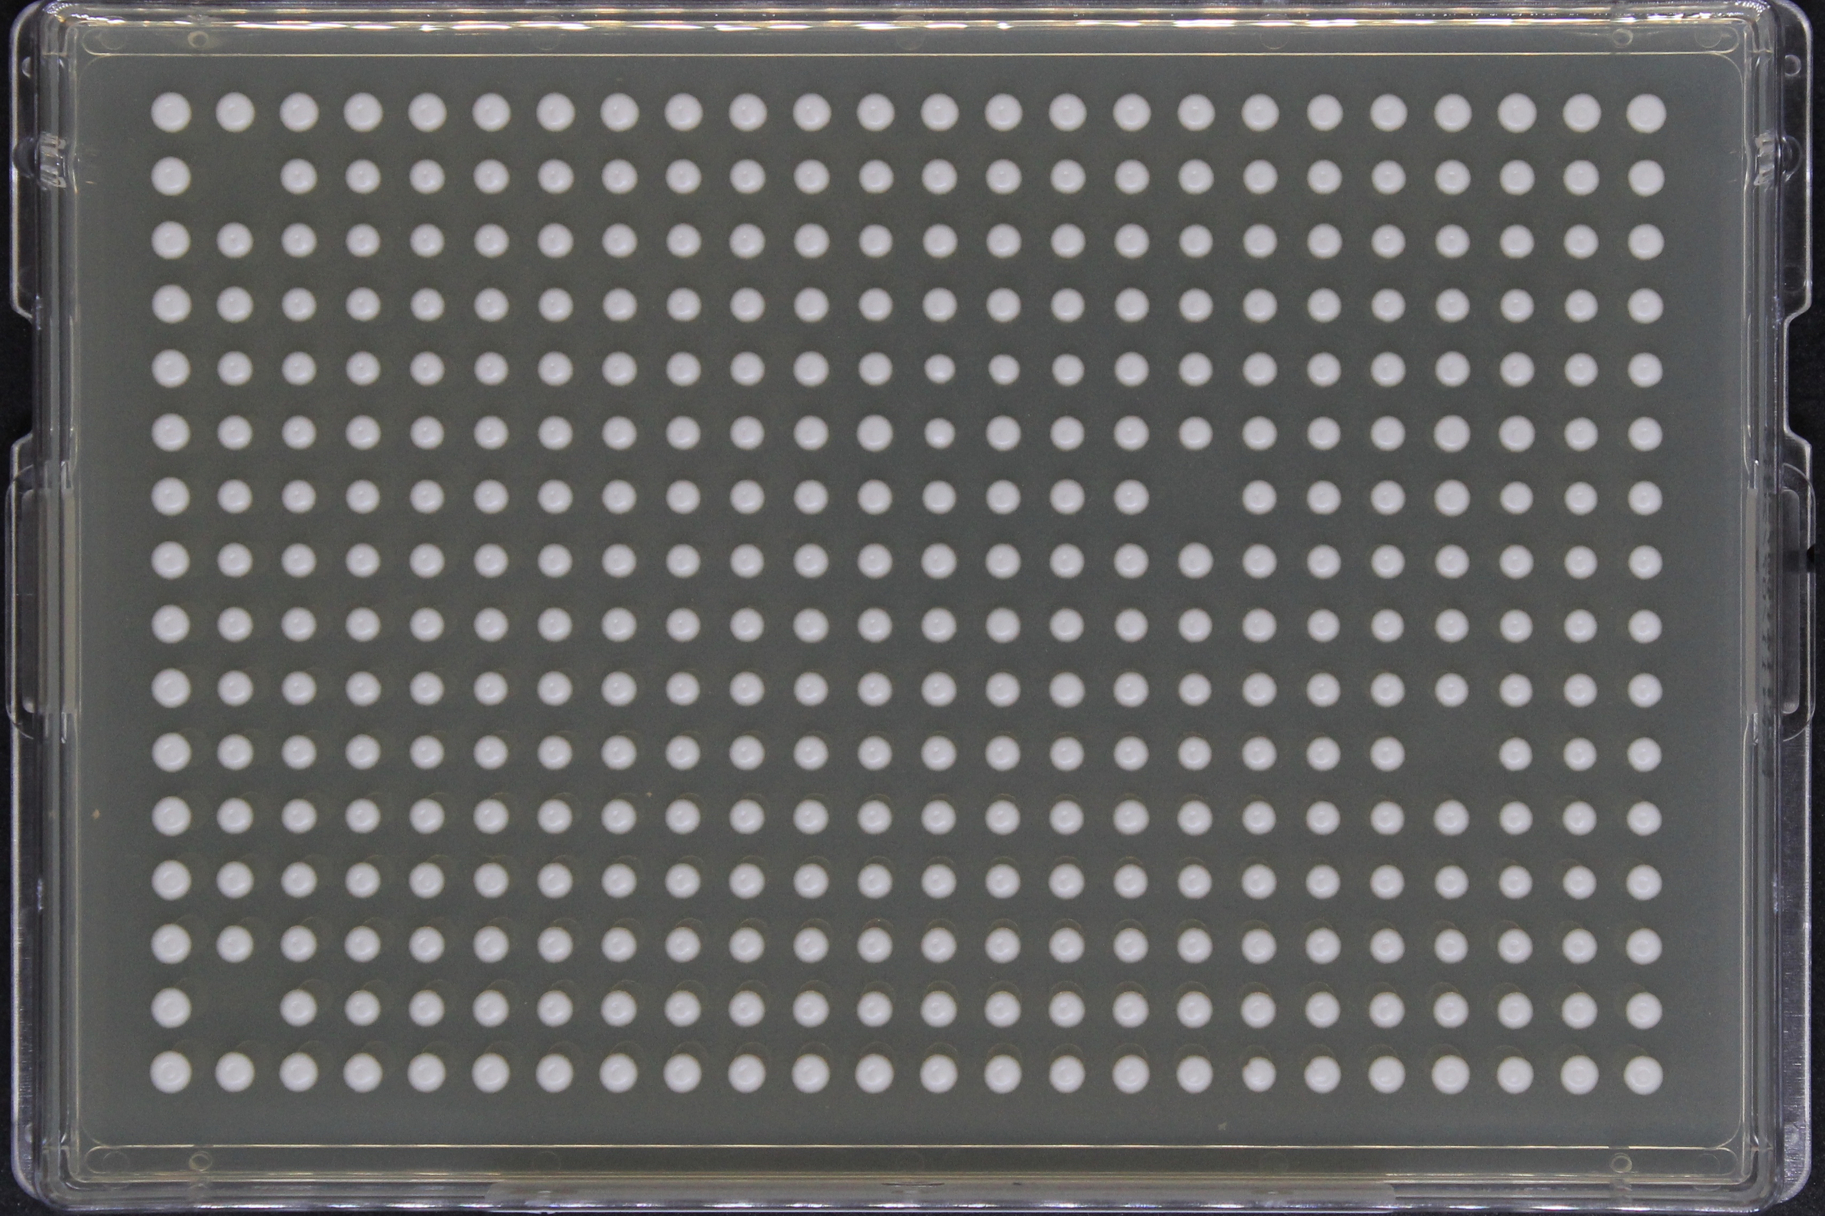
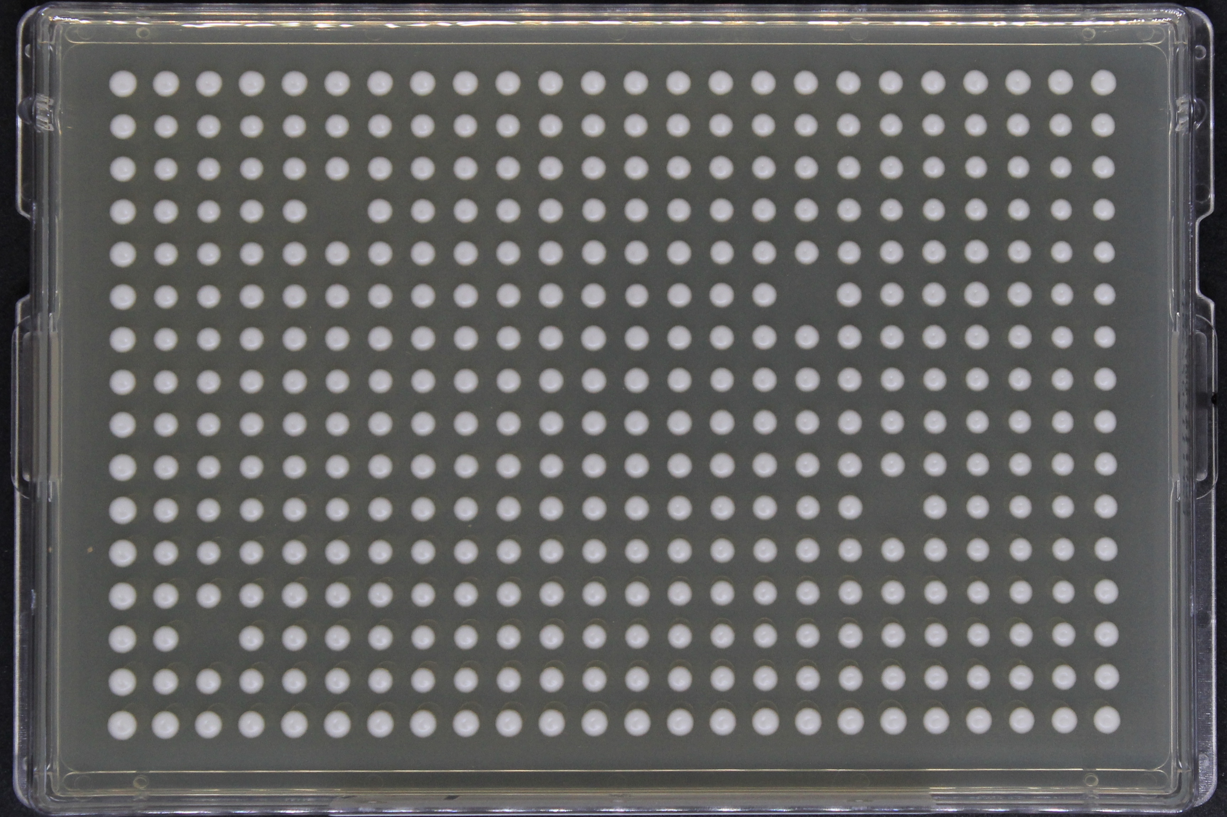
A
B
384 -
Density
Plates
Strain: FY4
Media: YPD
C
D
384-density glycerol stocks >> 384-density agar plates
Notes:
I am going quickly go through the workflow of a typical screen using this experiment I had conducted with FY4 on YPD media
Here we are looking at 4 384-density plates that each pinned from a 384-density microtiter glycerol stocks
Each of these colonies are FY4 with some intentional gaps on the colony grid
These plates, lets call them ABCD, were then used to upscale to four 1536 density plates..

Slide 9
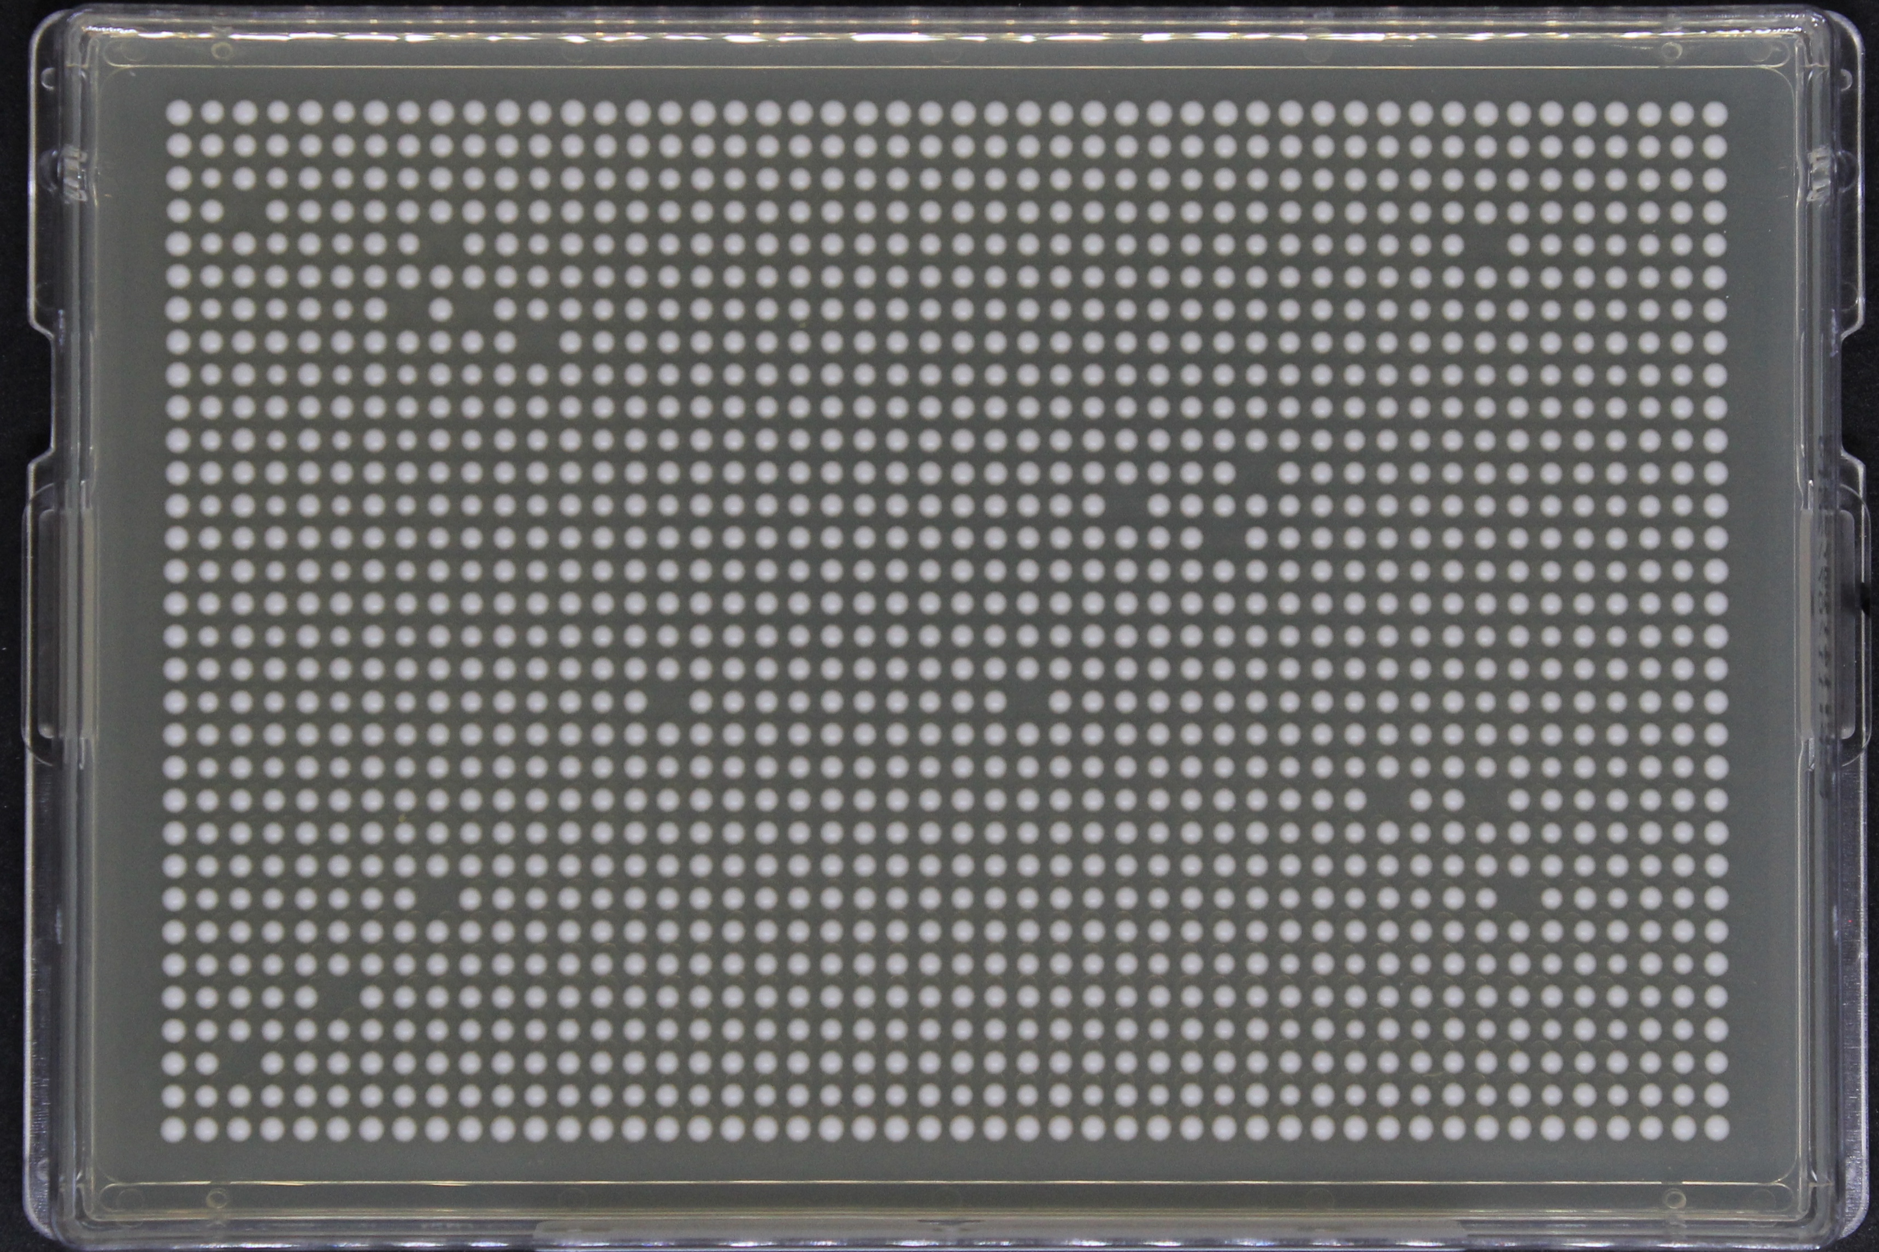
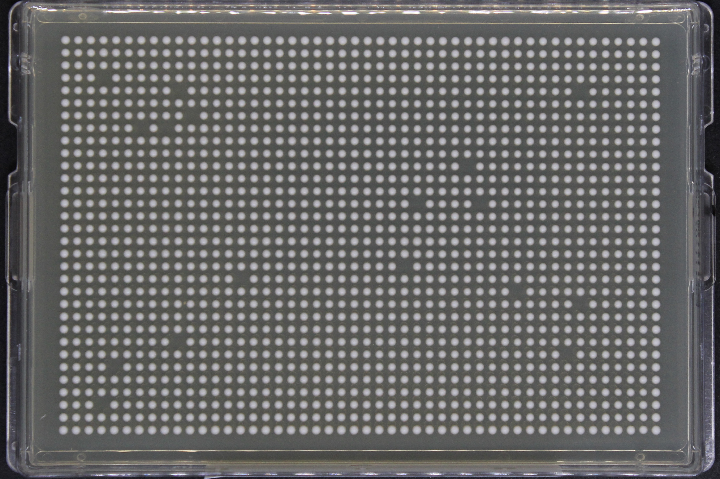
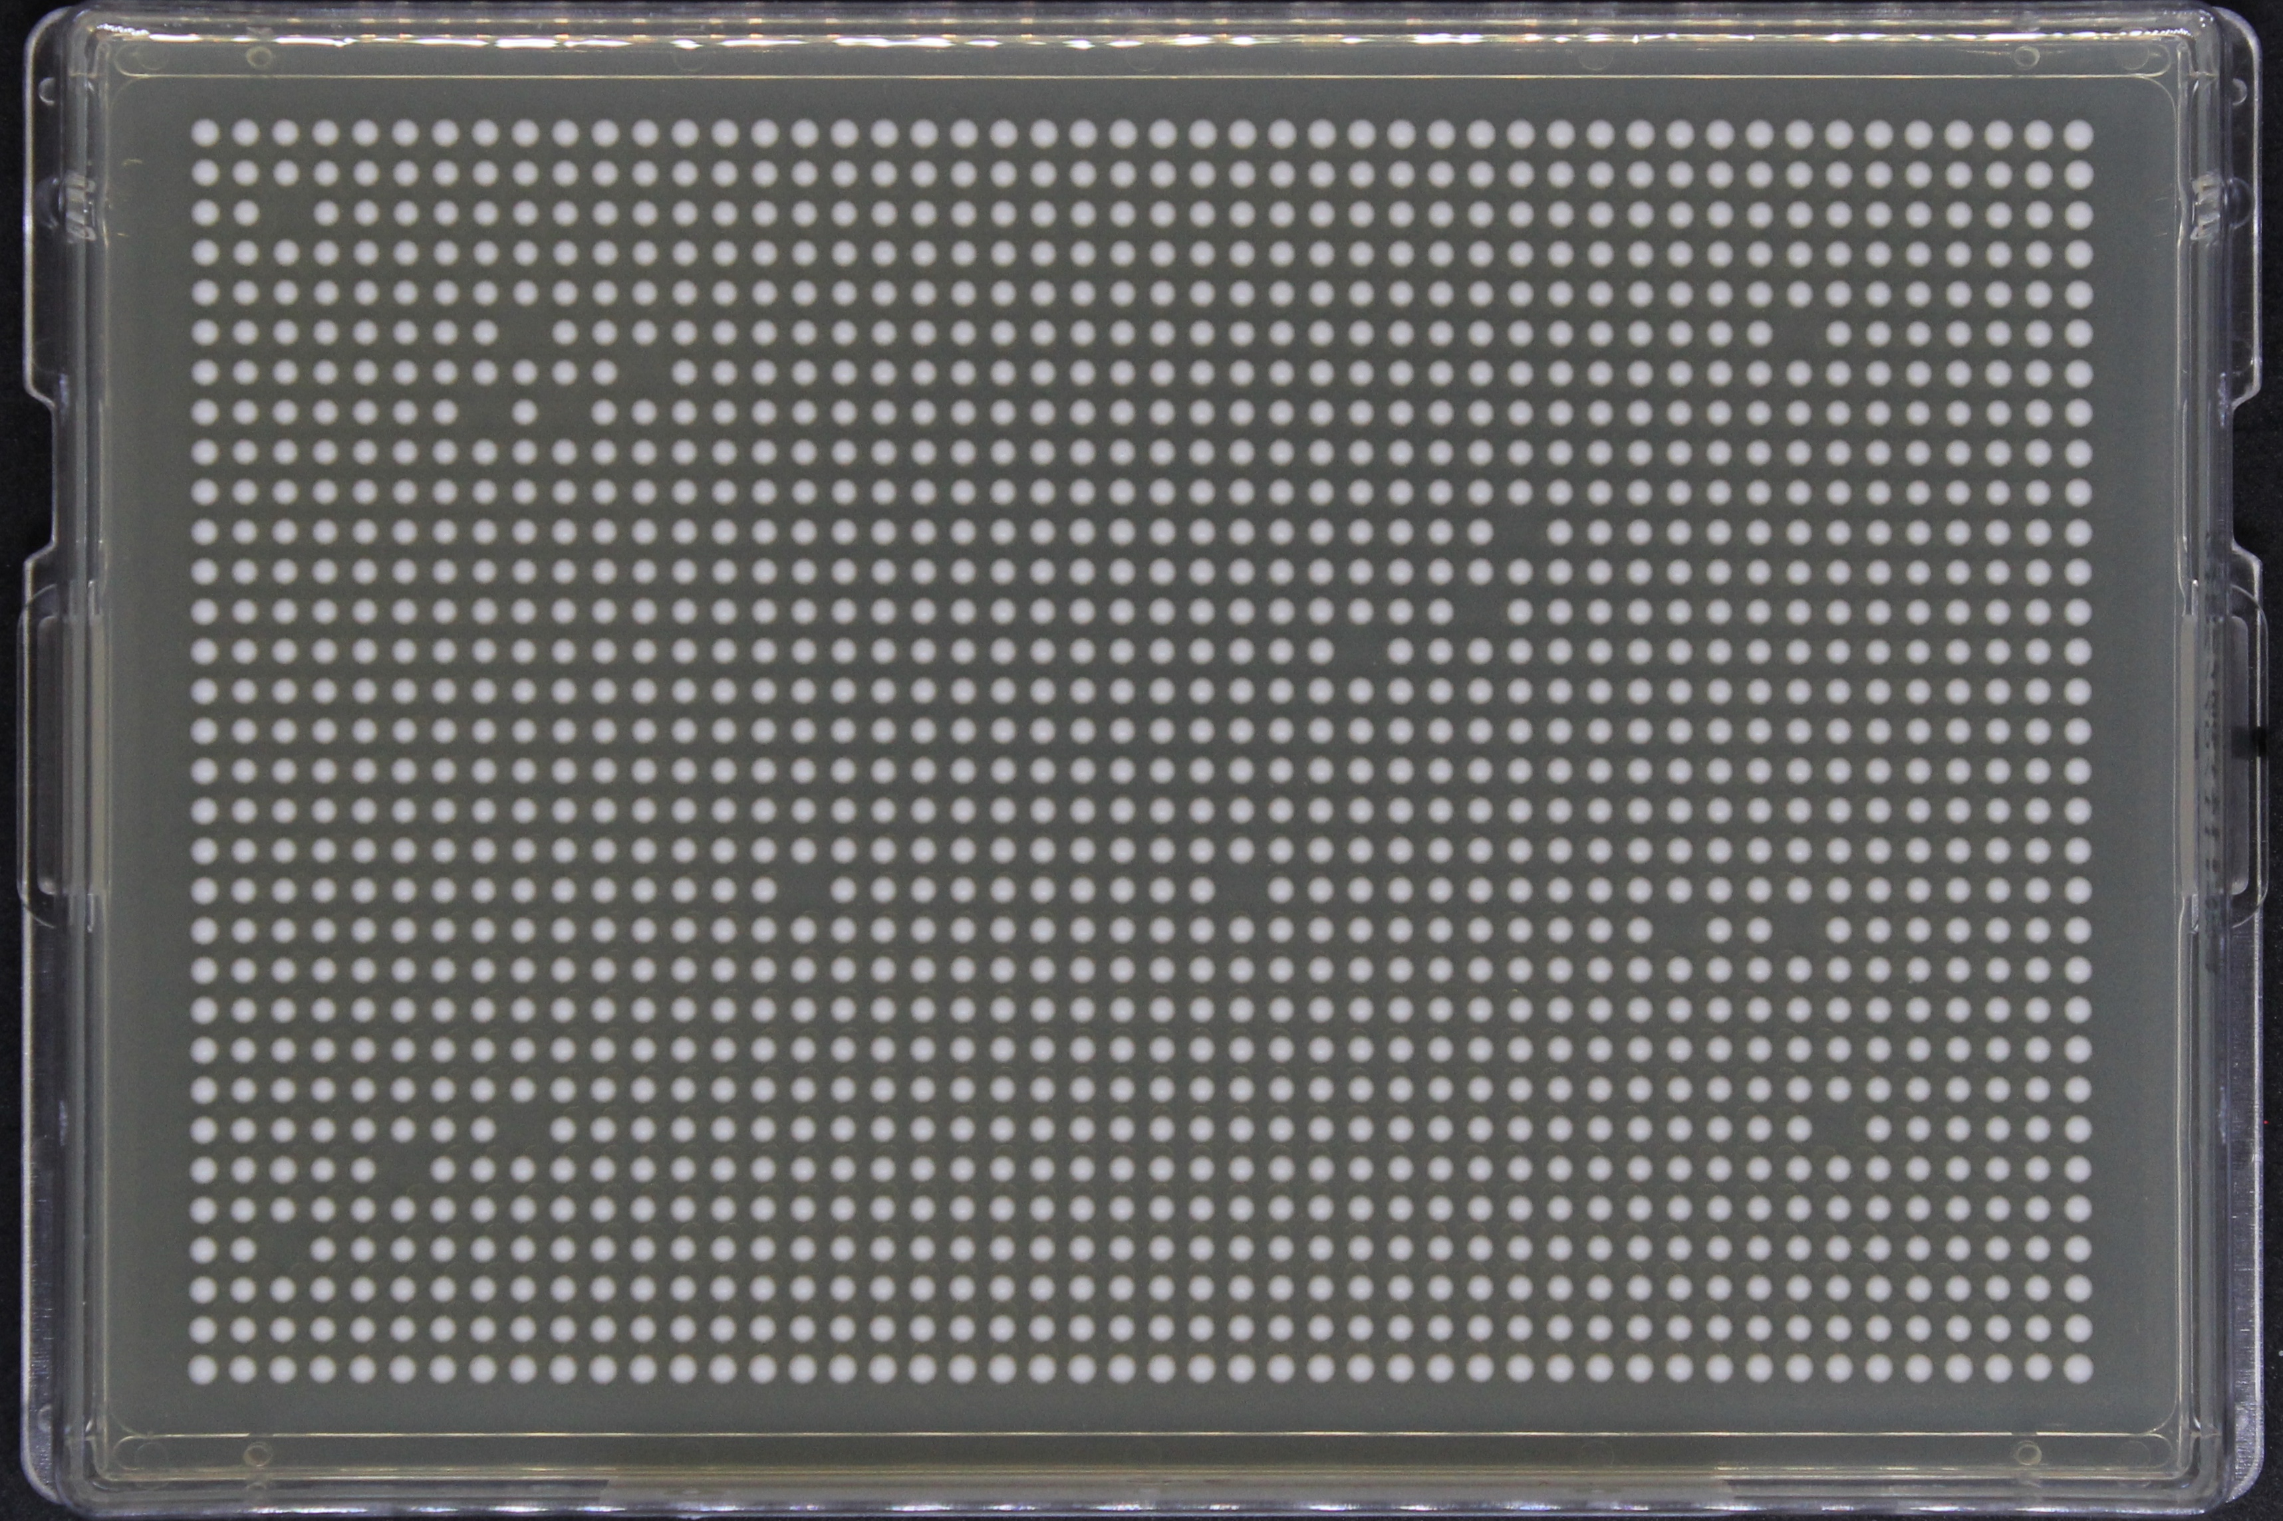
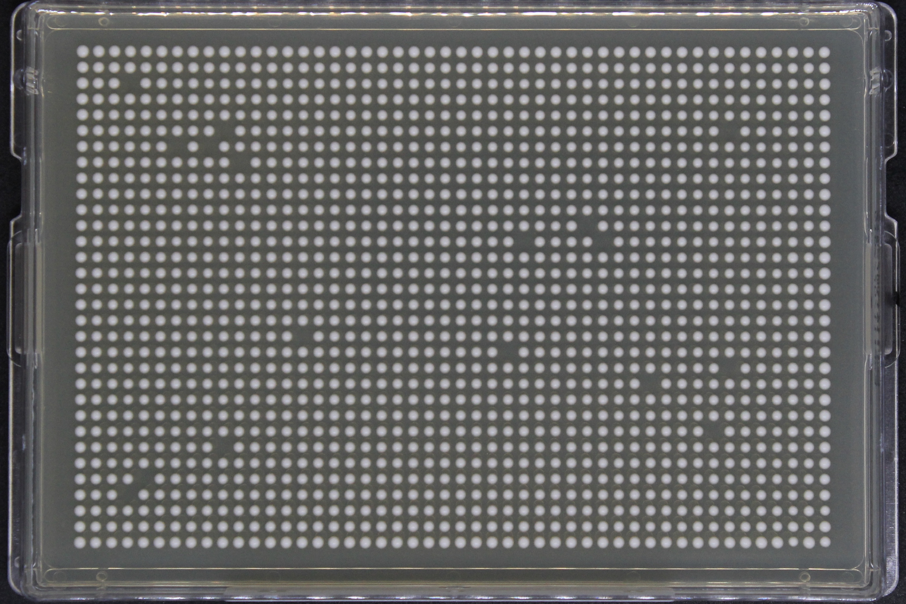
A B
C D
=L
D A
B C
=M
1536 -
Density
Plates
A
B
A
B
C
D
C
D
Strain: FY4
Media: YPD
A
B
A
B
C
D
C
D
C D
A B
=N
B C
D A
=O
384-density glycerol stocks >> 384-density agar plates >> 1536-density agar plates
Notes:
Each of these plates is made using unique arrangements of the 384-density plates
And what I mean by that is, if we look at the top left corner of this plate L here then alternating colonies are coming from the lower density plates in a pattern like such
So while plate L was made with an ABCD pattern, plate M was DABC and so on and so forth
In a real experiment where you are dealing with plates from a collection this helps randomize neighbors and positions

Slide 10
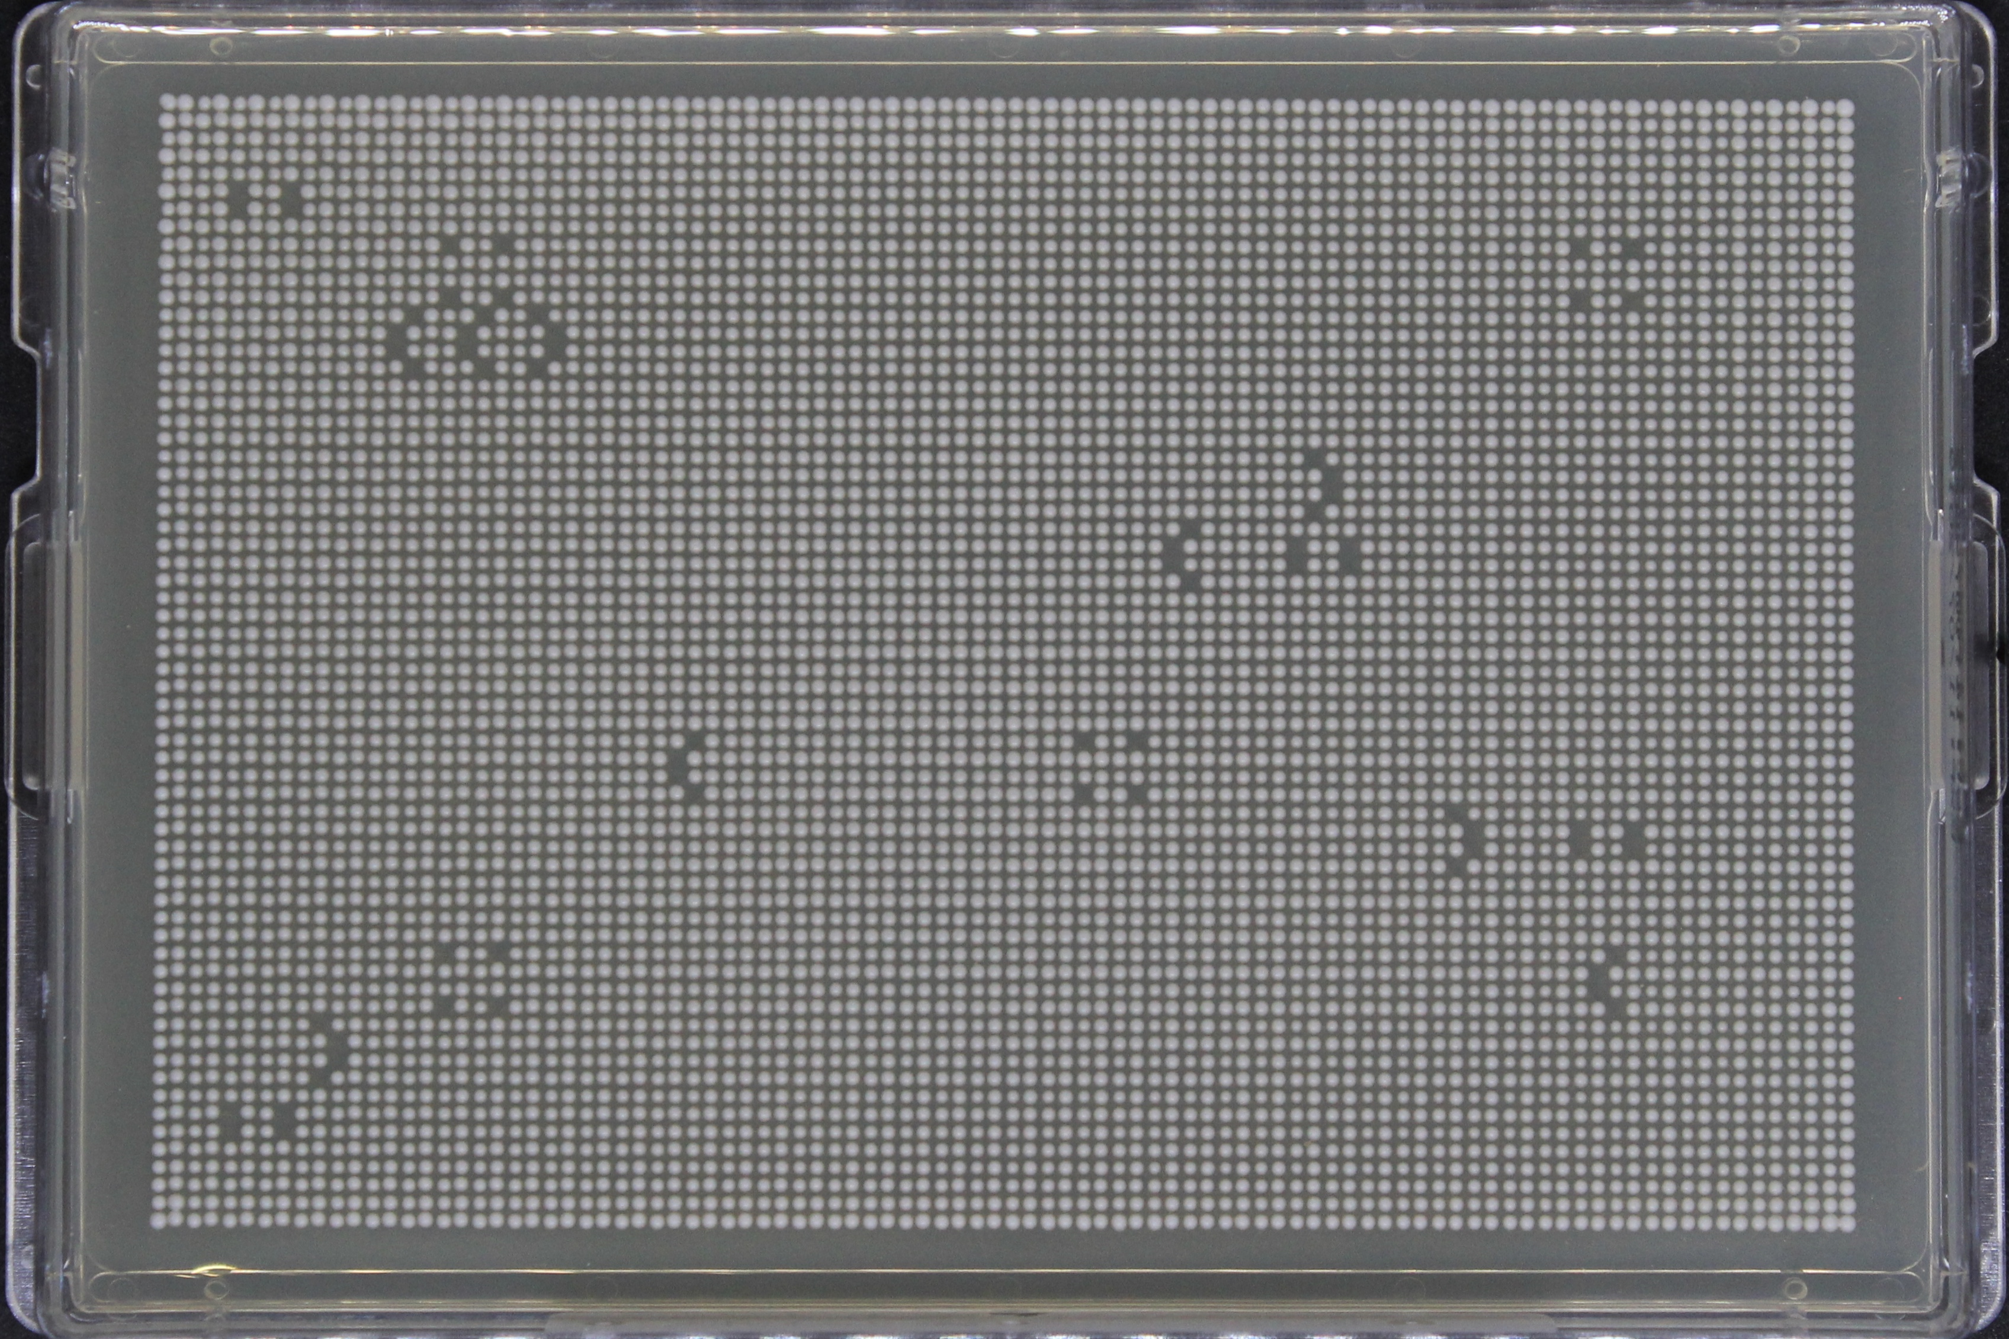
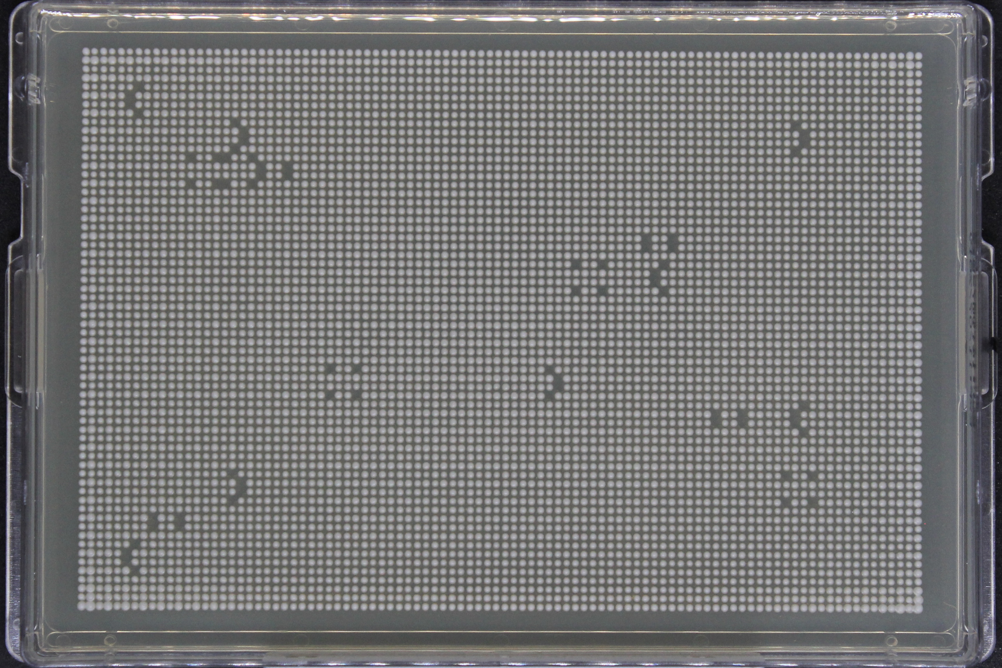
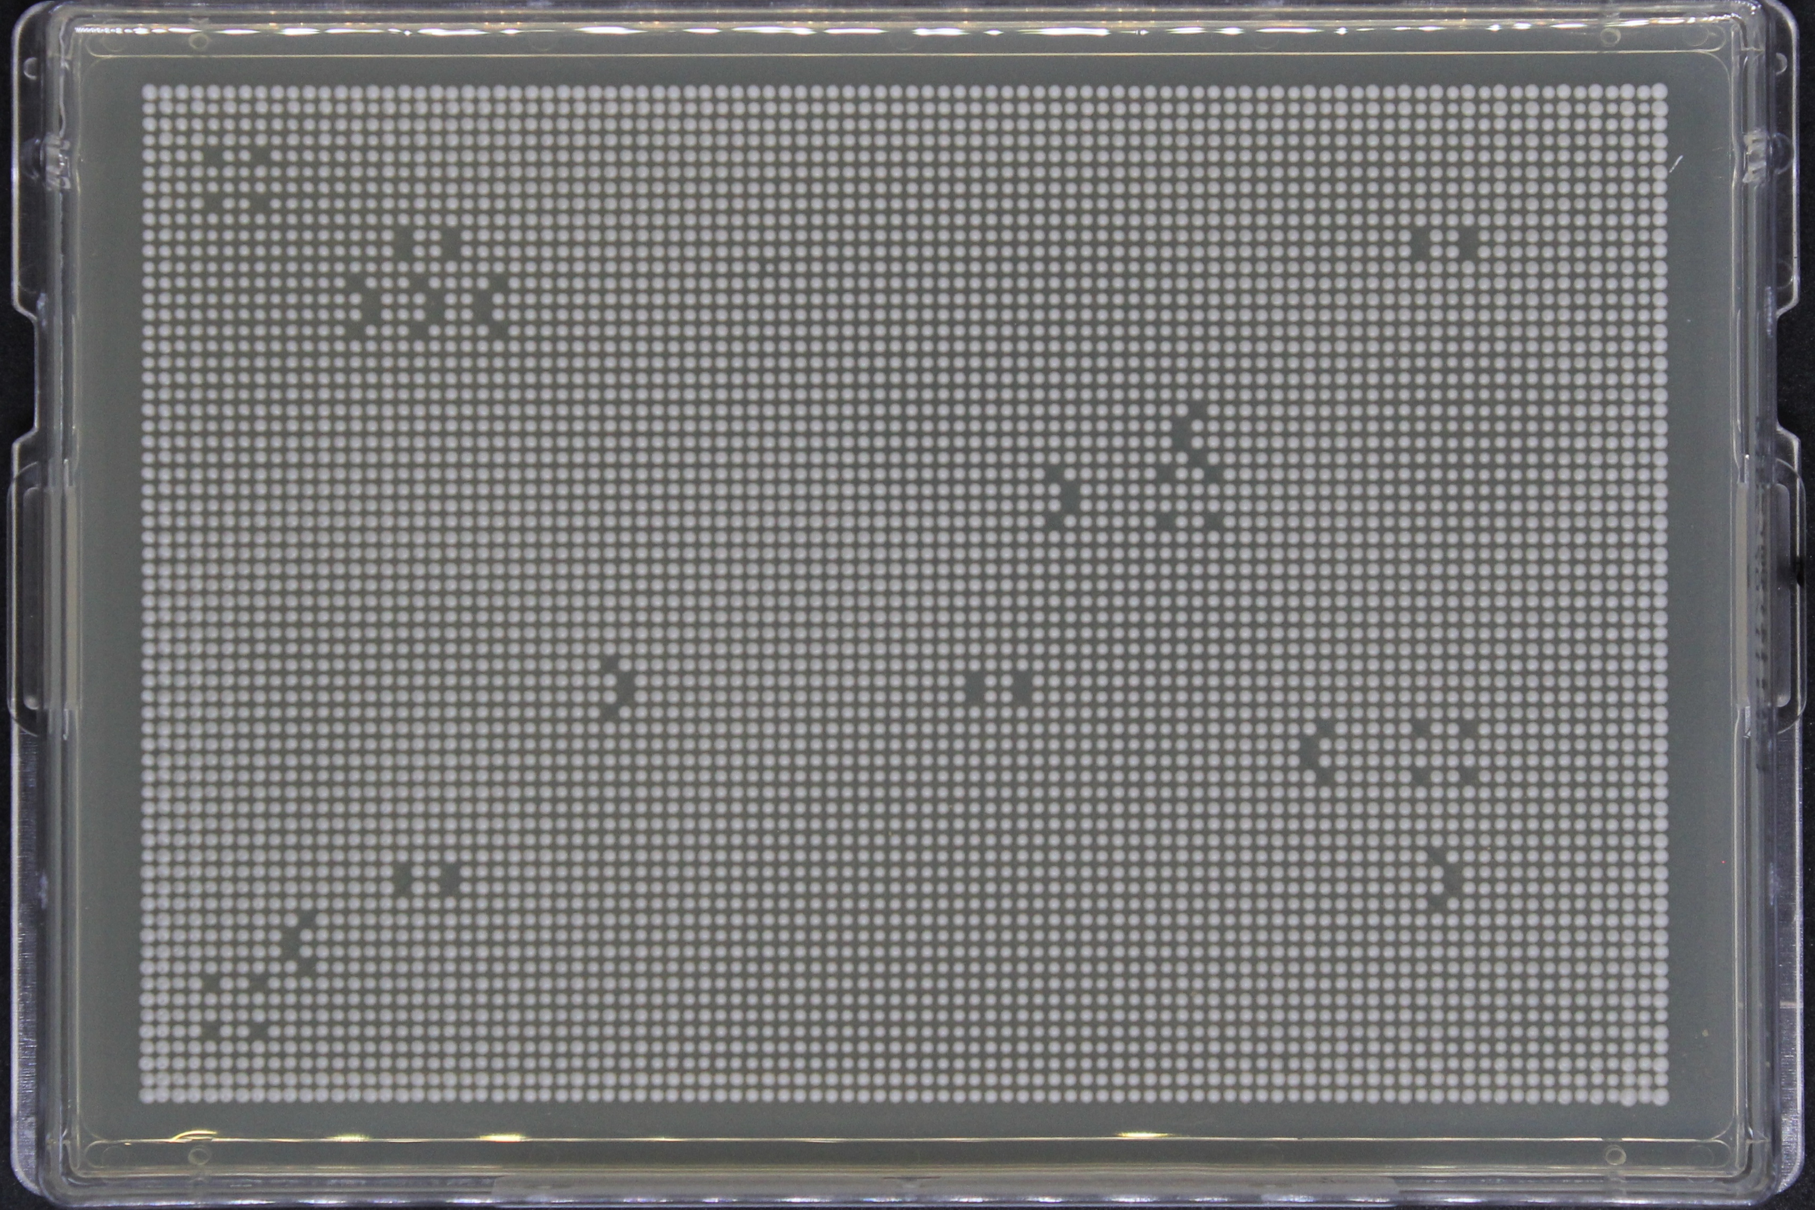
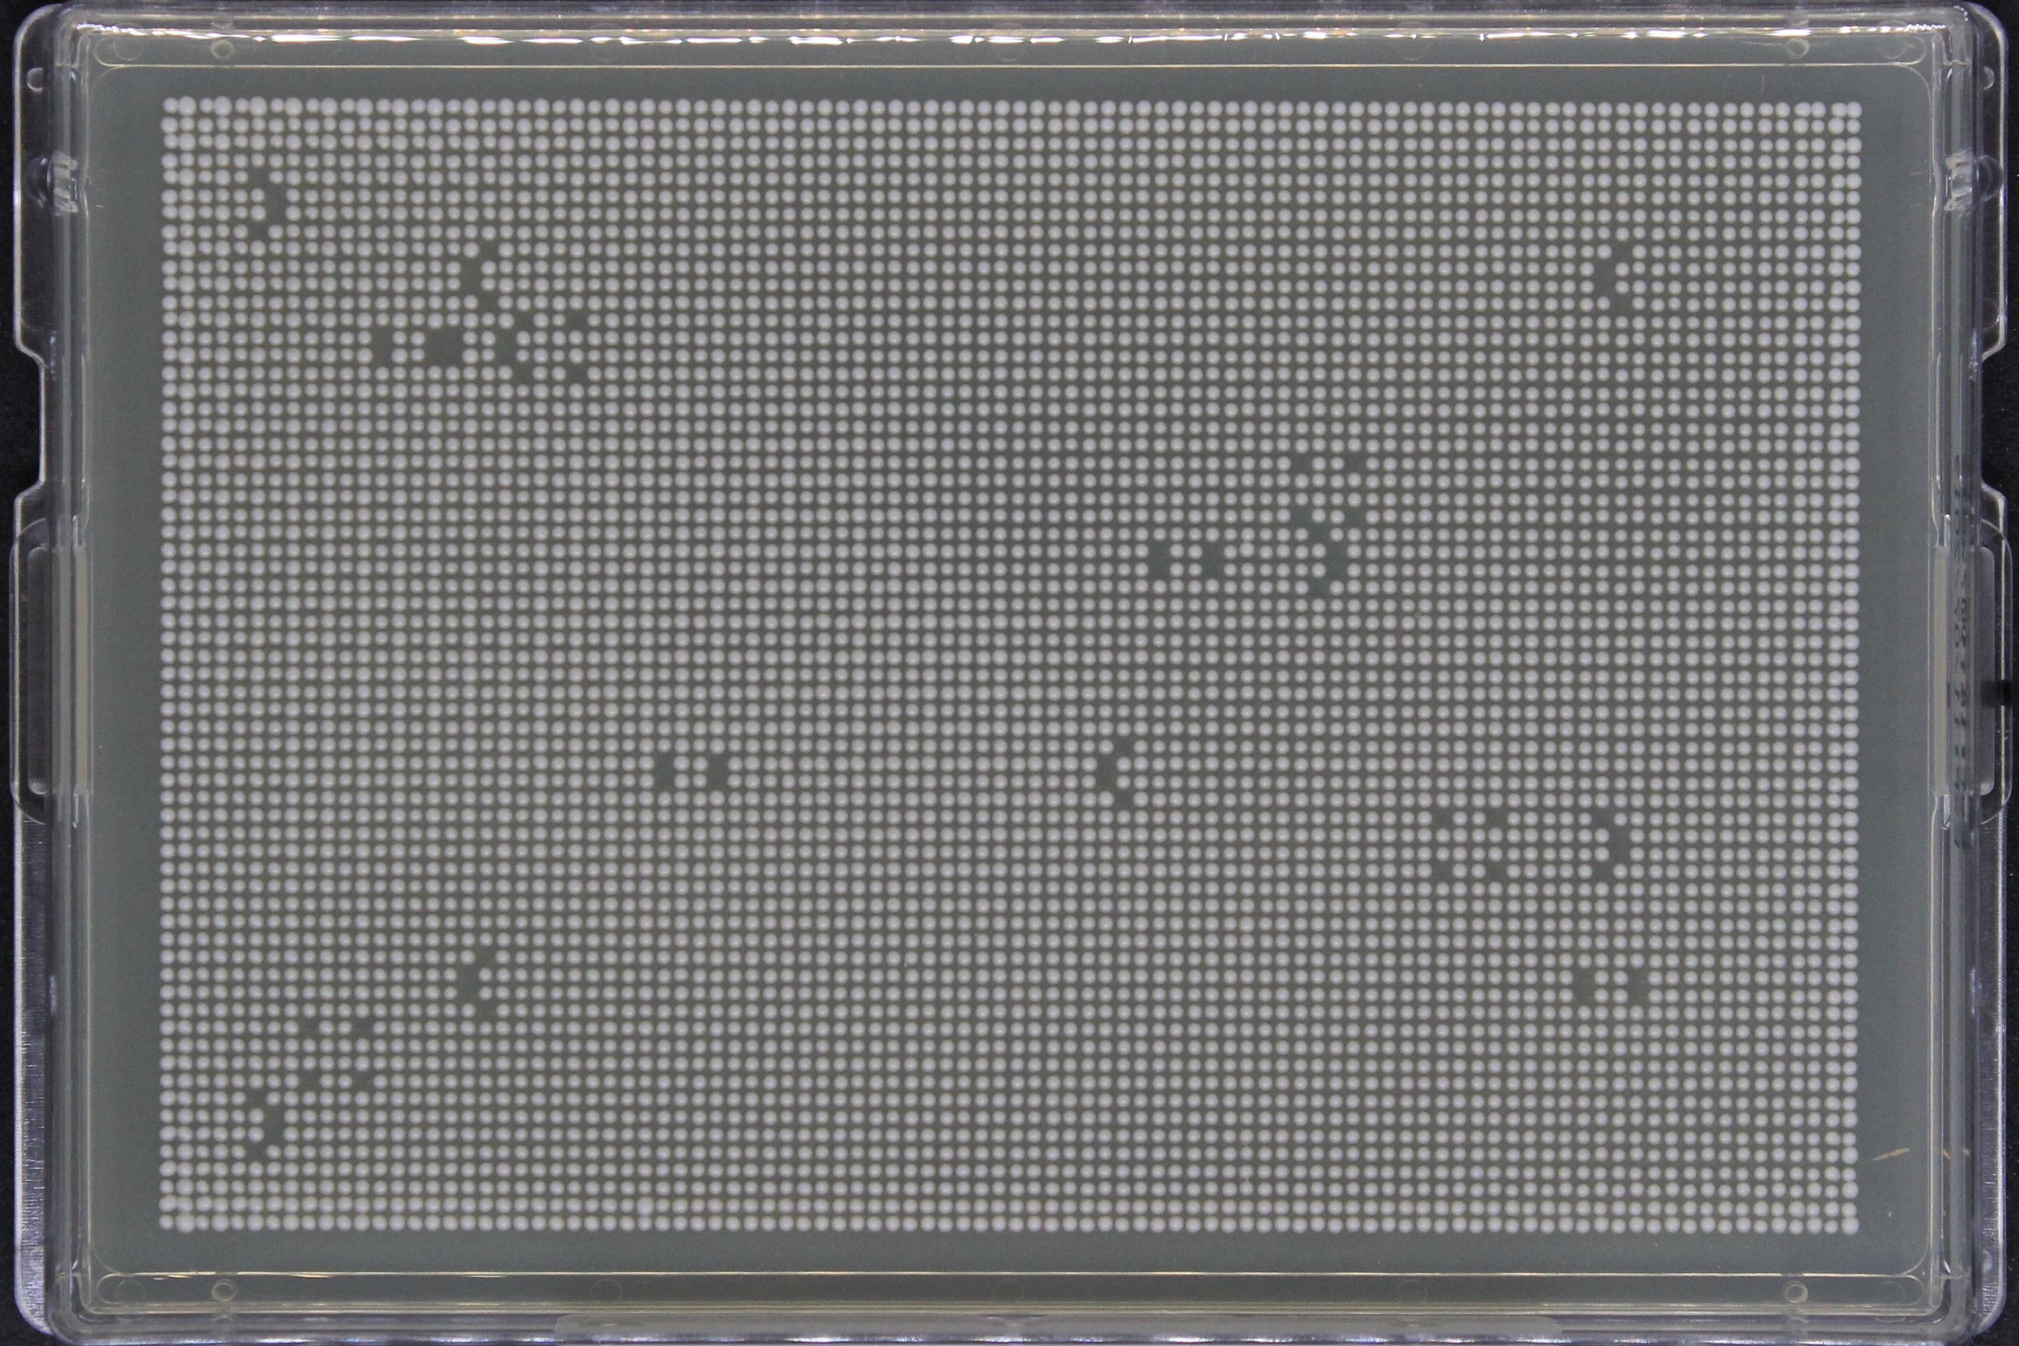
L M
N O
=W
O L
M N
=X
6144 -
Density
Plates
Strain: FY4
Media: YPD
N O
L M
=Y
M N
L O
=Z
384-density glycerol stocks >> 384-density agar plates >> 1536-density agar plates >> 6144-density agar plates
Notes:
The 1536 density plates are then upscaled into 6144 density using a similar technique
Usually it is these higher density plates that are imaged and then used for colony size estimations

Slide 11
Any questions so far?
Background
Colony based high-throughput screens (CBHTS)
Problem of spatial bias in CBHTS
How does LI Detector address this issue?
Notes:
So far, I have given you a general idea of what CBHTS are and why I am interested in them
And I would like to pause for a brief moment to see if there are any questions…

Slide 12
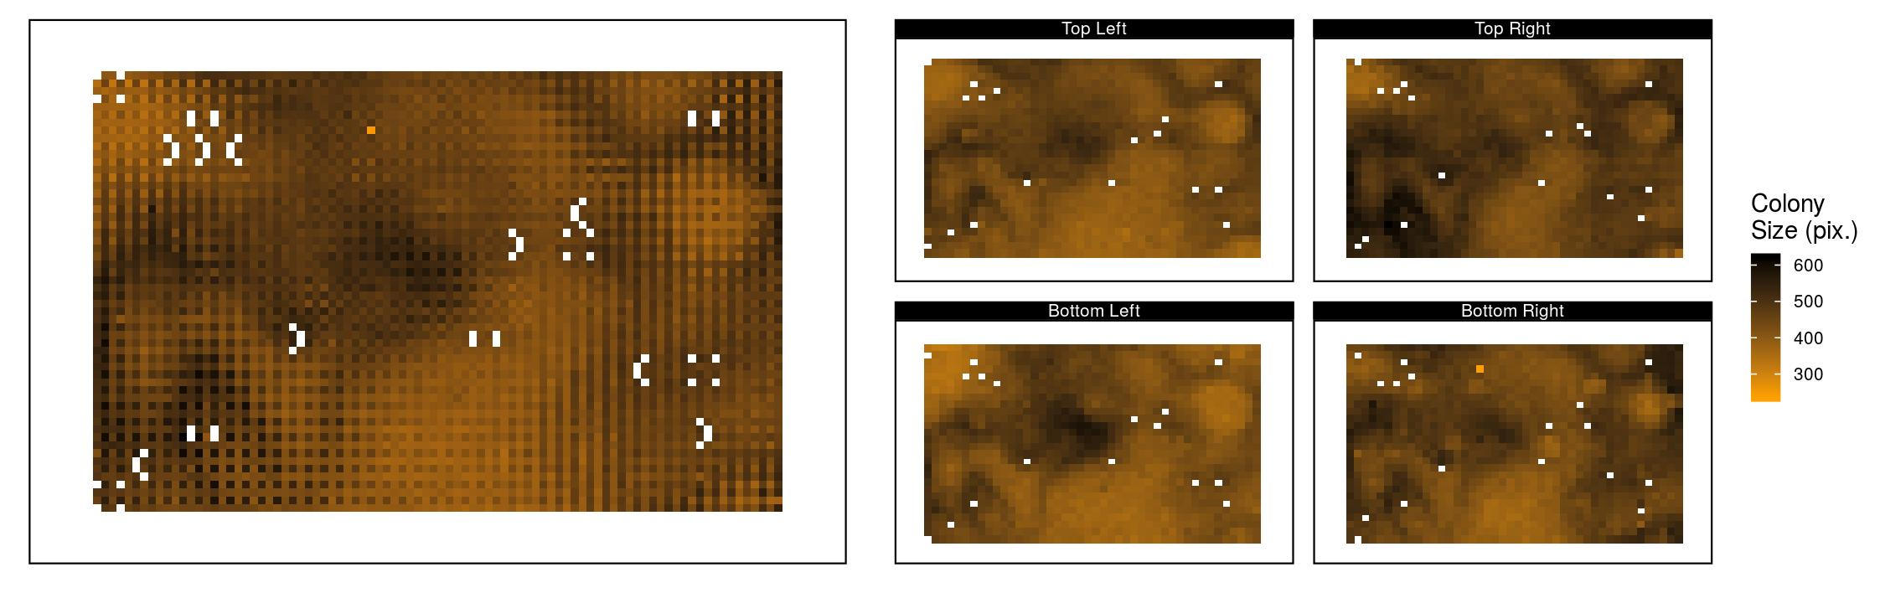
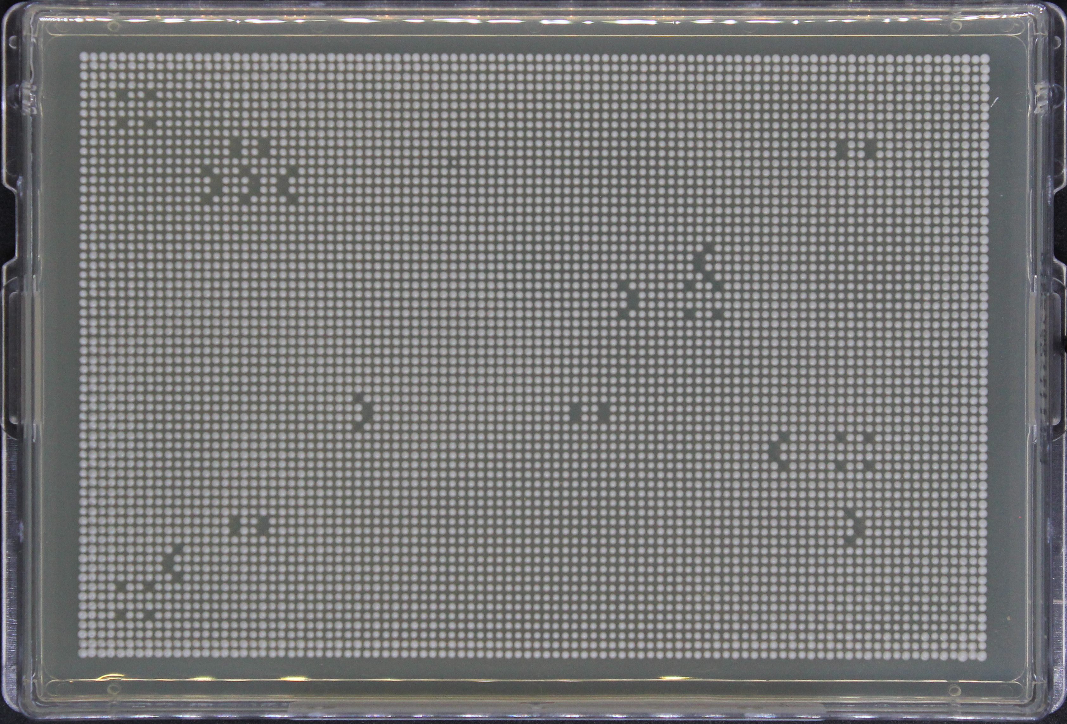
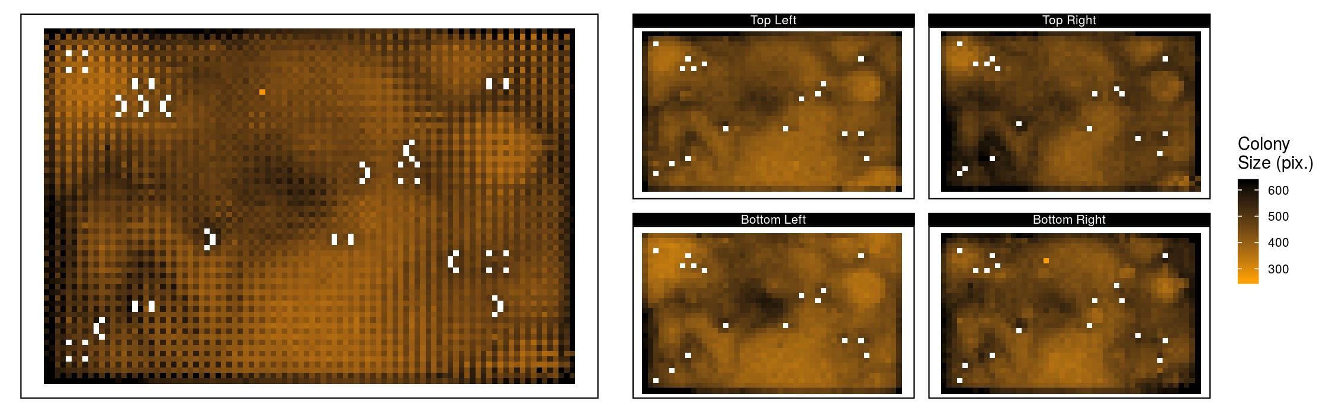
Spatial Bias
systematic differences in colony sizes that arise due to technical reasons
Notes:
Something that these CBHTS are plagued with is the problem of spatial bias – which are systematic differences in colony sizes that arise due to technical reasons
If we look at this 6144-density plate over here all the colonies on it look to be of a similar size which should be expected given that they contain an isogenic population…
But when I convert this same plate into a heatmap where each tile represents a colony on the plate and the colors represent colony size in pixels then a whole different pattern emerges
Here the white spaces are gaps in the colony grids that we have intentionally left
As you can see there is one-fold increase between the lowest colony size and the highest
This is spatial bias and there are a variety of them…

Slide 13
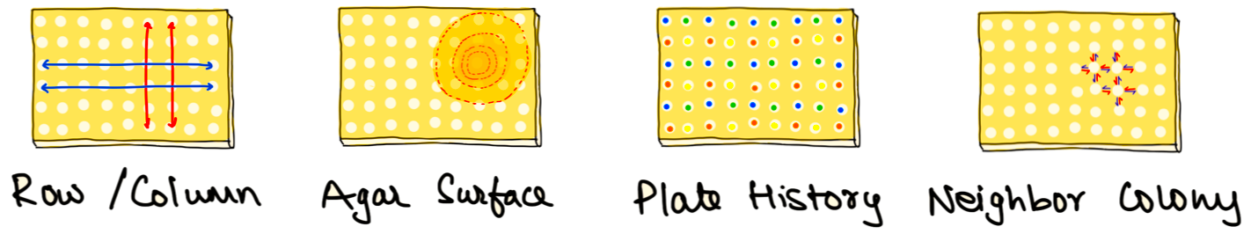
Varieties of spatial bias
Notes:
The overall pattern that you are noticing occurs due to bumps and bruises of the agar surface
Then there is systematic row/column kind of patterns that you notice in this region
There is also a checkerboard kind of pattern you notice here which happens due to the upscale procedure as every alternating colony is coming from a different source
Lastly, there is a more elusive neighbor colony effect where colonies growing near dead or slow growing colonies tend to grow more due to the increased access to nutrients

Slide 14
Correcting for spatial bias is a huge challenge
“The environment can rarely be maintained constant across plates”
- Zackrisson et al. 2016
“The environment can rarely be maintained constant across plates on a plate”
- Saurin Parikh
Notes:
As you can imagine correcting for the spatial bias can be a huge challenge because:
I will go as far as to say that:

Slide 15
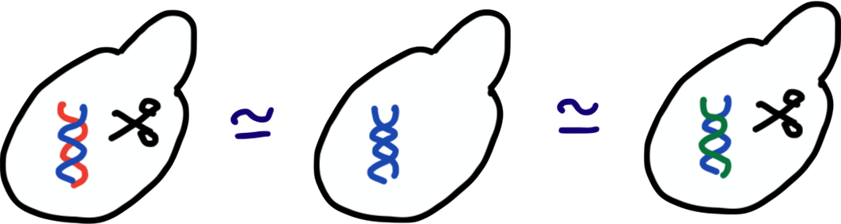
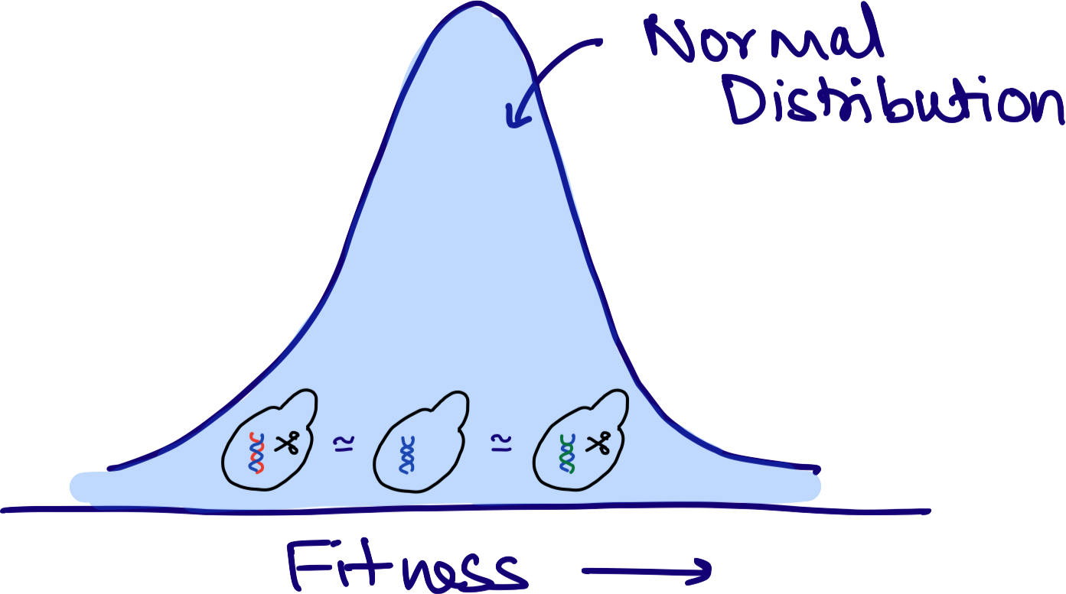
Existing Methods of Spatial Bias Correction
Assumptions
Limitations
Small fitness effects cannot be observed
1.
mutant #1
wild type
mutant #2
Screens with fewer plates
Screens with fewer mutants
Conditions producing polarizing fitness effects
Testing the uncharacterized genome
Anything less than a genome-wise screen in ’normal’ condition
2.
Collins et al. 2006, Baryshnikova et al. 2010, Wagih et al. 2013, Young et al. 2013, Bean et al. 2014, Zackrisson et al. 2016
Notes:
Over the years, multiple methods have tried to address this problem and have been successful to certain extent
Most of them work on the assumption that majority of genetic perturbations have minimal effects on fitness
Limiting their ability to observe small fitness effects
And that most screens would contain a normal distribution of fitness effects – limiting their ability to be used for screen with fewer plates, fewer mutants, conditions that produce polarizing fitness effects or testing of the uncharacterized genome whose fitness effects are largely unknown.
As you can notice more than one of these limitation would restrict my ability to characterize the proto-genes using CBHTS
Now I should mention that although one of these method was used in our paper that I mentioned earlier, we were only able to see large fitness effects

Slide 16
Any questions?
Background
Colony based high-throughput screens (CBHTS)
Problem of spatial bias in CBHTS
How does LI Detector address this issue?
Notes:
So now that I have introduced the problem of spatial bias and why existing methods that correct for it aren’t ideal choices for me
I would like to pause again to see if there are any questions

Slide 17




Hypothetical (!) Scenario
Spatial Context
Observation
20 mph
10 mph
10 mph
5 mph
Relative Fitness
Saurin/Usain = 0.5
Nelson/Usain = 0.5
Notes:
So in order to address this issue of spatial bias correction lets look at this hypothetical scenario
Nelson being the resourceful scientist that he is….
Covid19 resistant clones of Usain Bolt who is a Olympic champion in sprinting
Without really knowing our spatial context we were able to correct for our difference in speeds

Slide 18
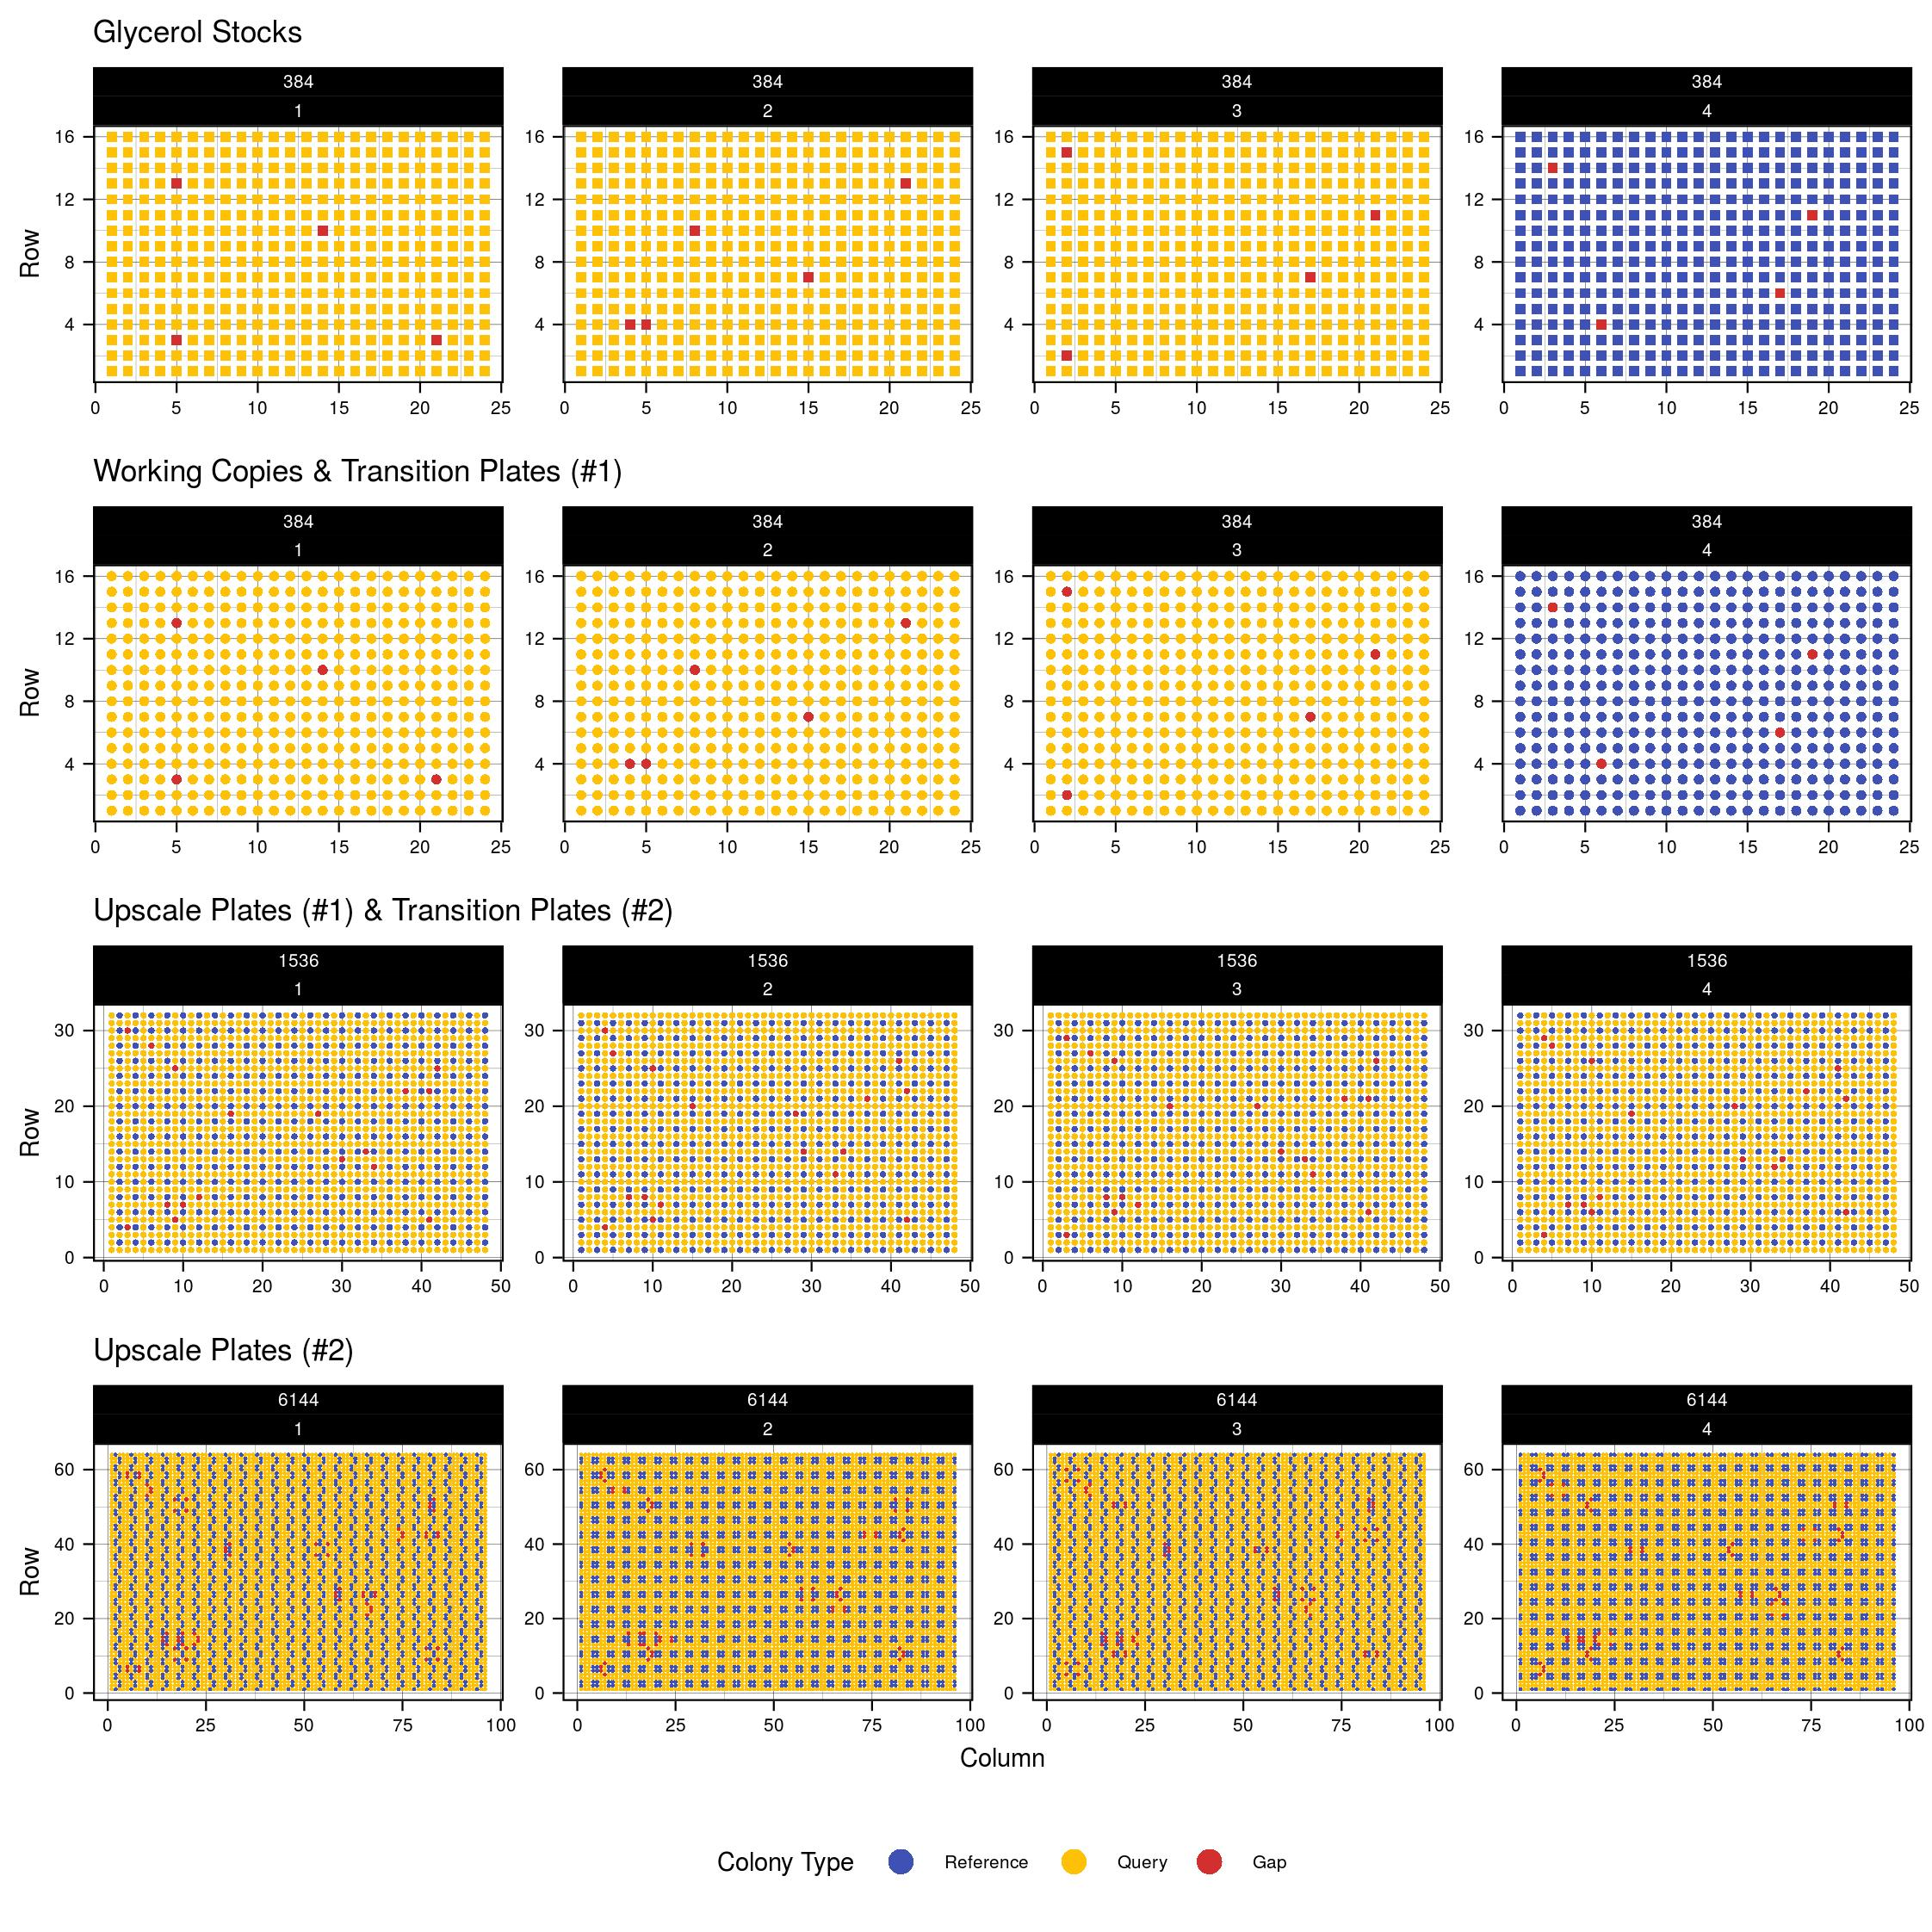
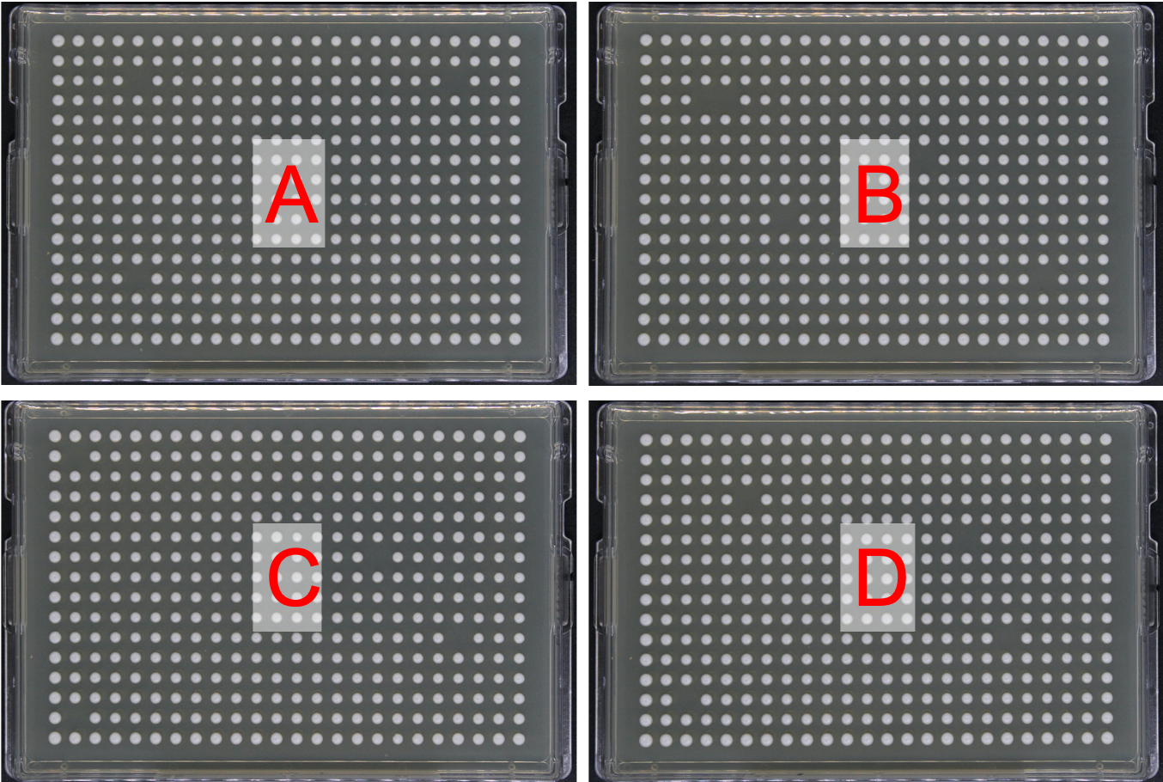
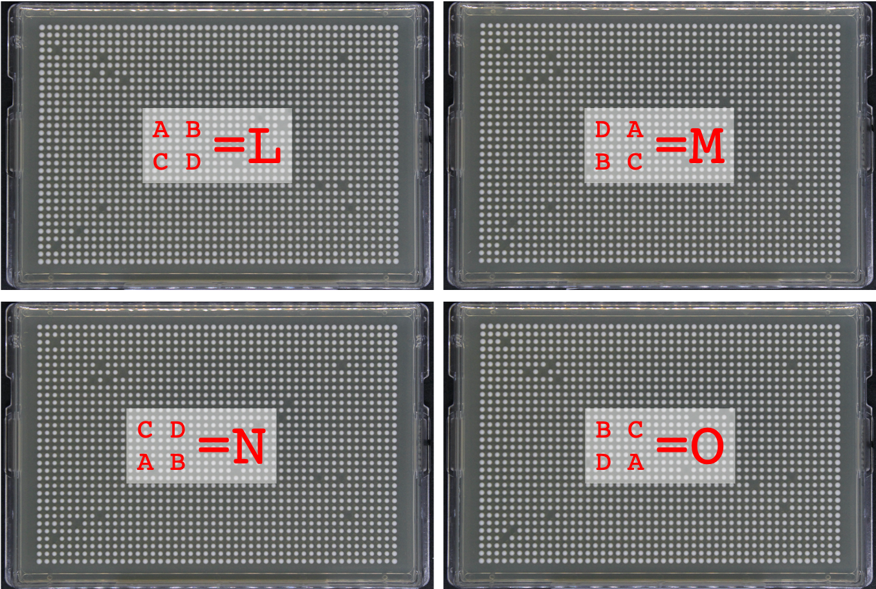
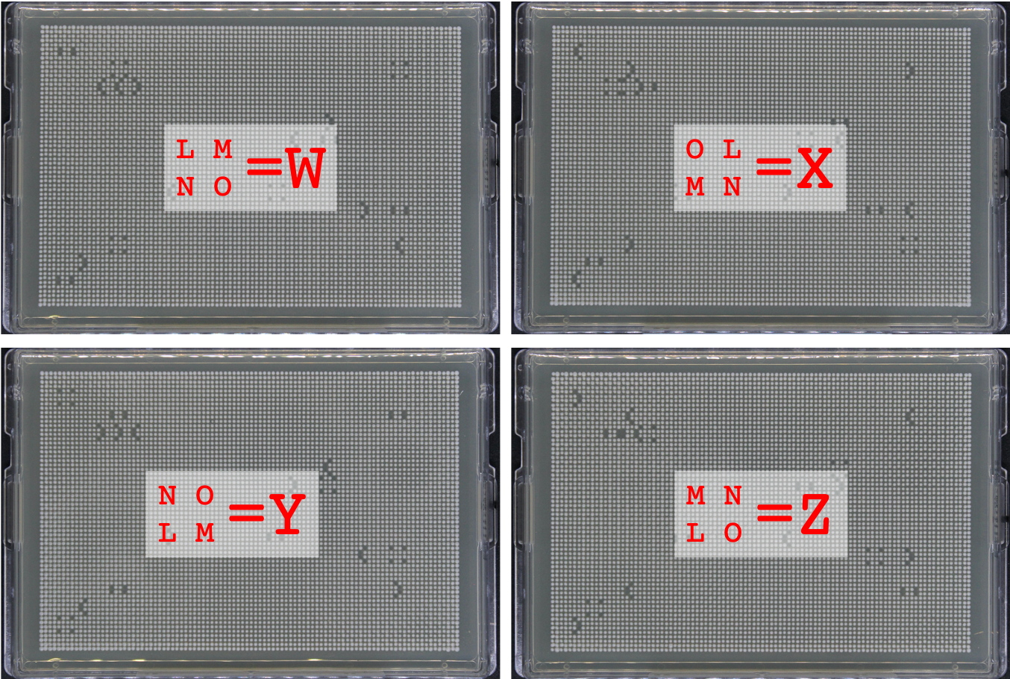

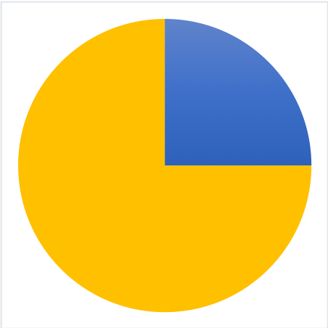

How to apply this concept in CBHTS?
Find a way to introduce a reference population
Reference Mutants Gaps

Slide 19

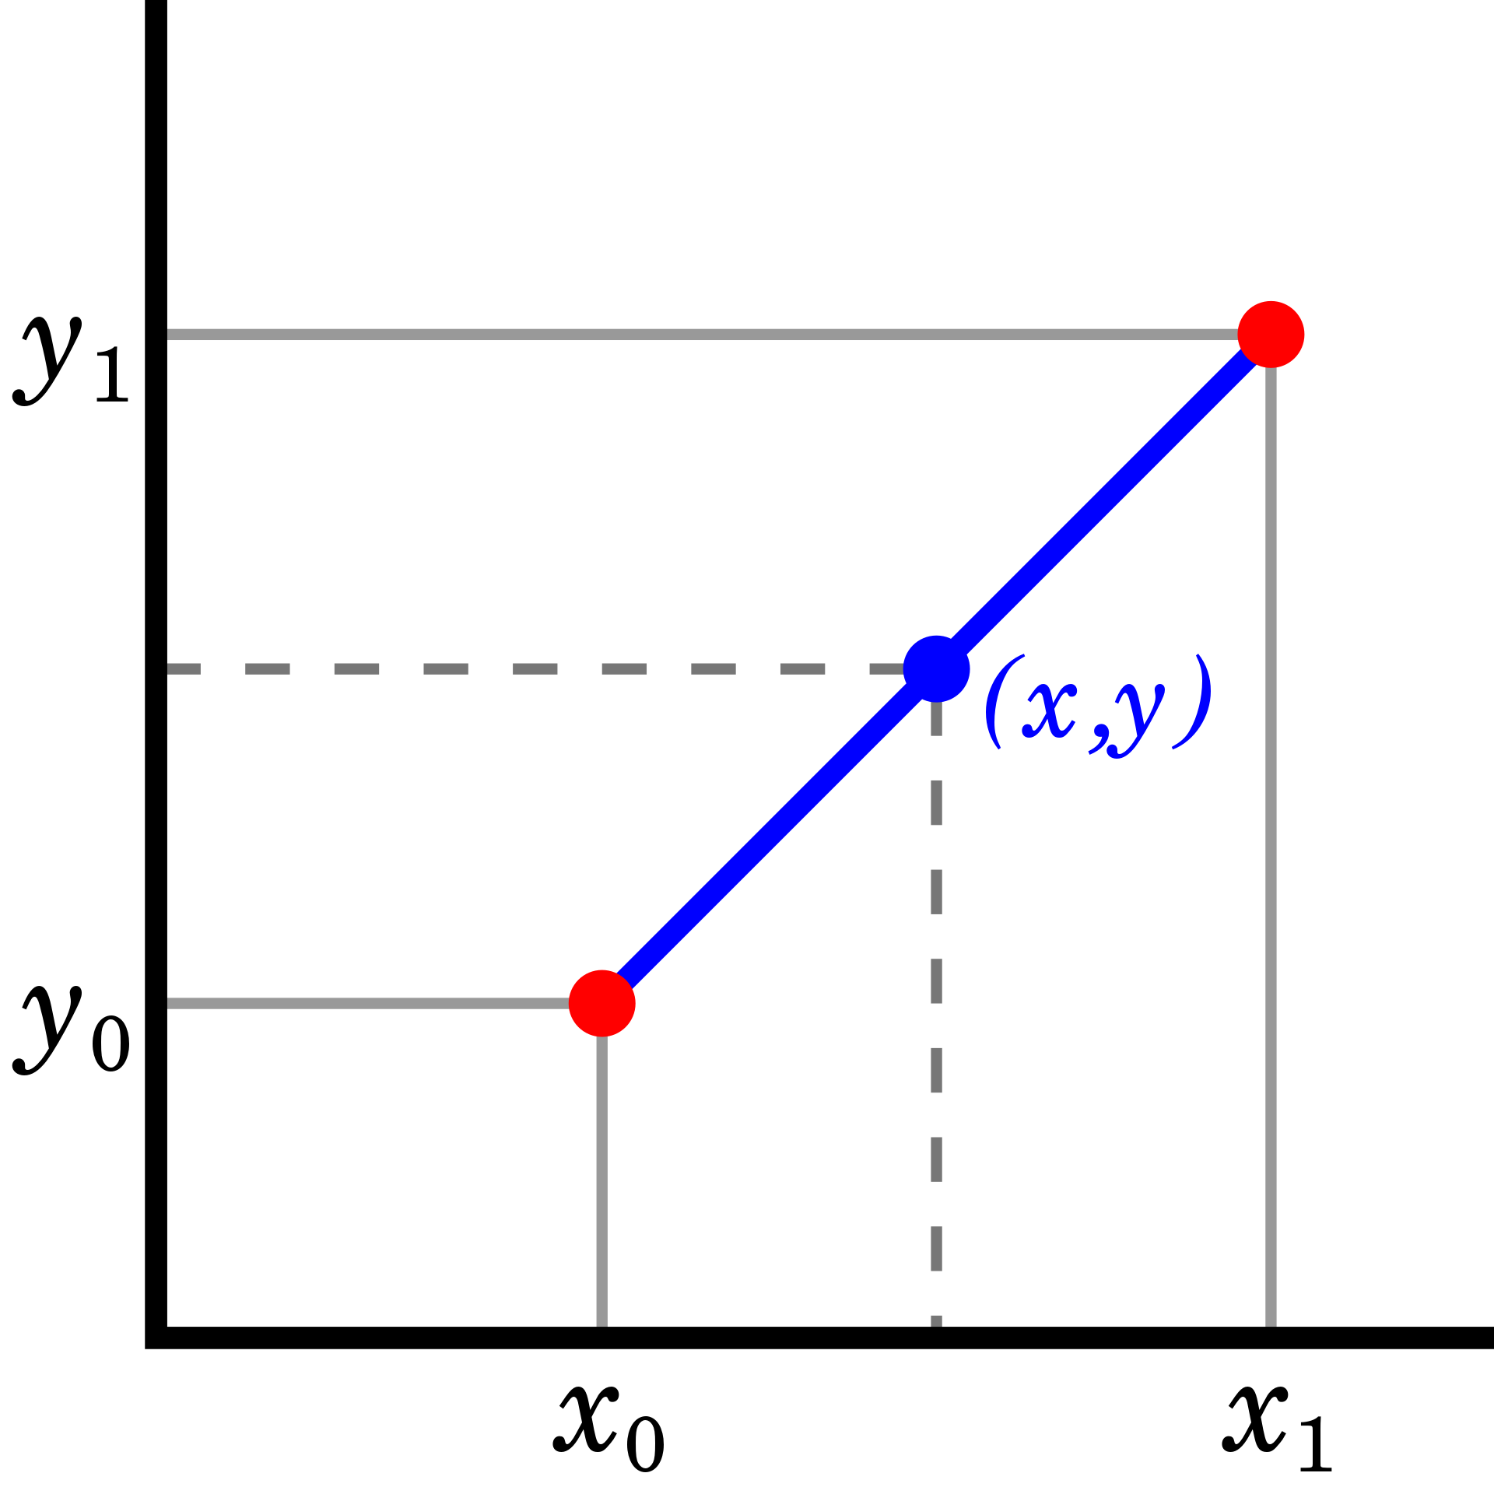
How to apply this concept in CBHTS?
Find a way to introduce a reference population
Find a way to use that to correct spatial bias
Reference
Mutants
Gaps

Slide 20
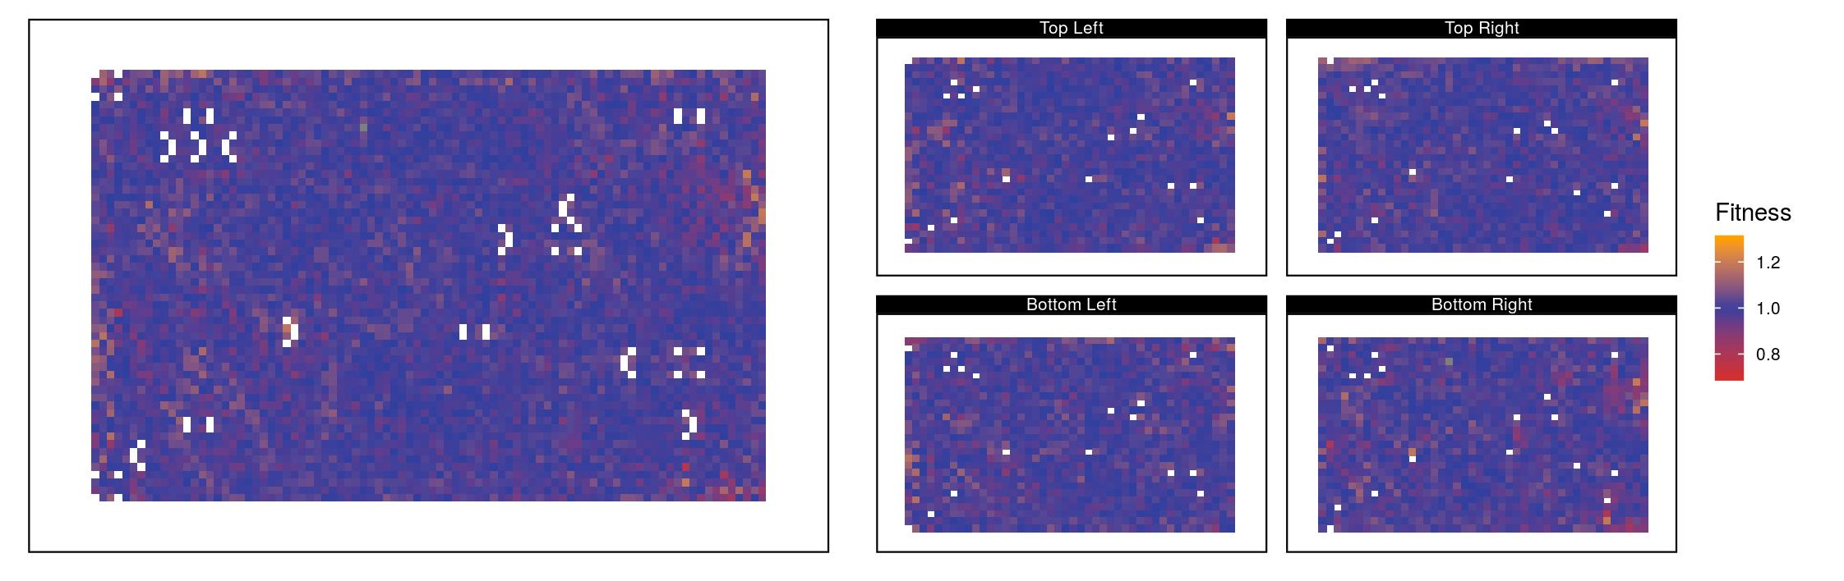
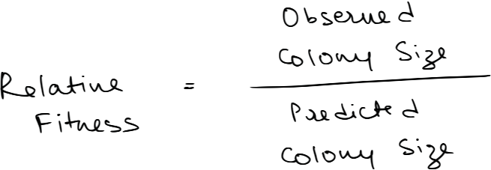
Removing Spatial Bias
>
Variability in observation =
Spatial bias + Biological variability
Variability in observation =
Biological variability
Notes:
say what simply I am correcting for here before explaining all the detail
some quantification to say that i solve the problem! statistical clarification
put them together situation

Slide 21
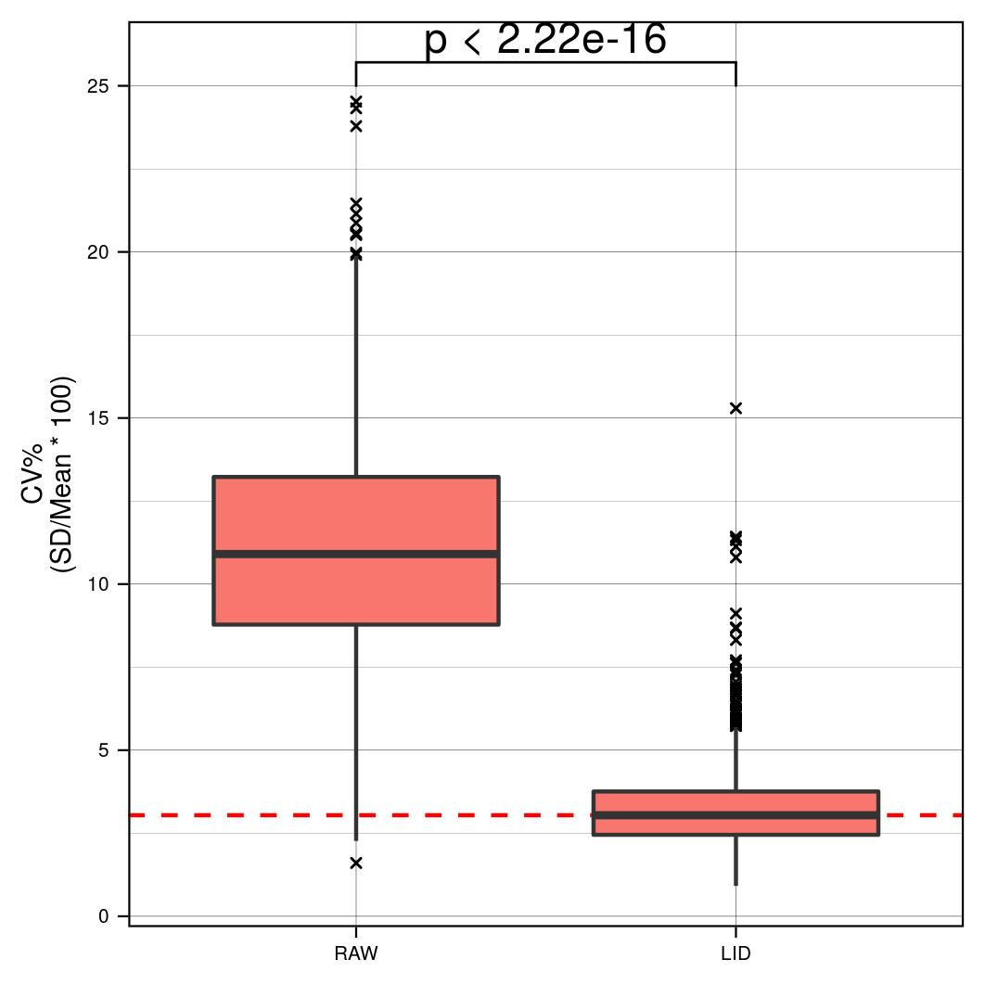
Removing Spatial Bias

Slide 22
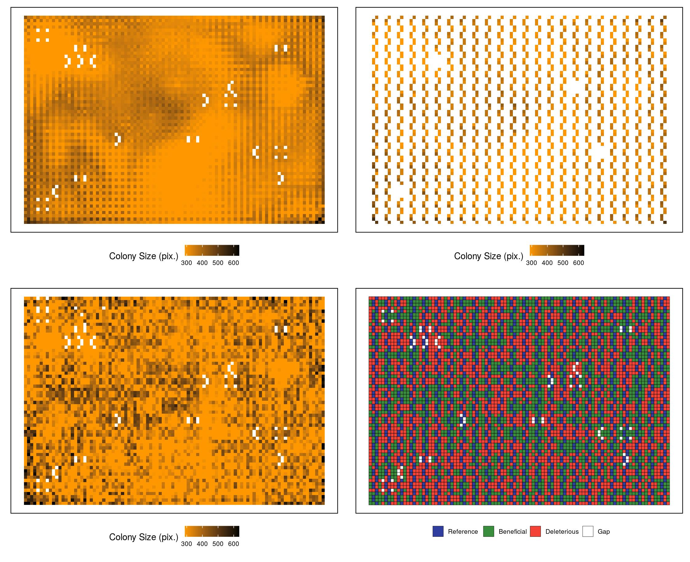
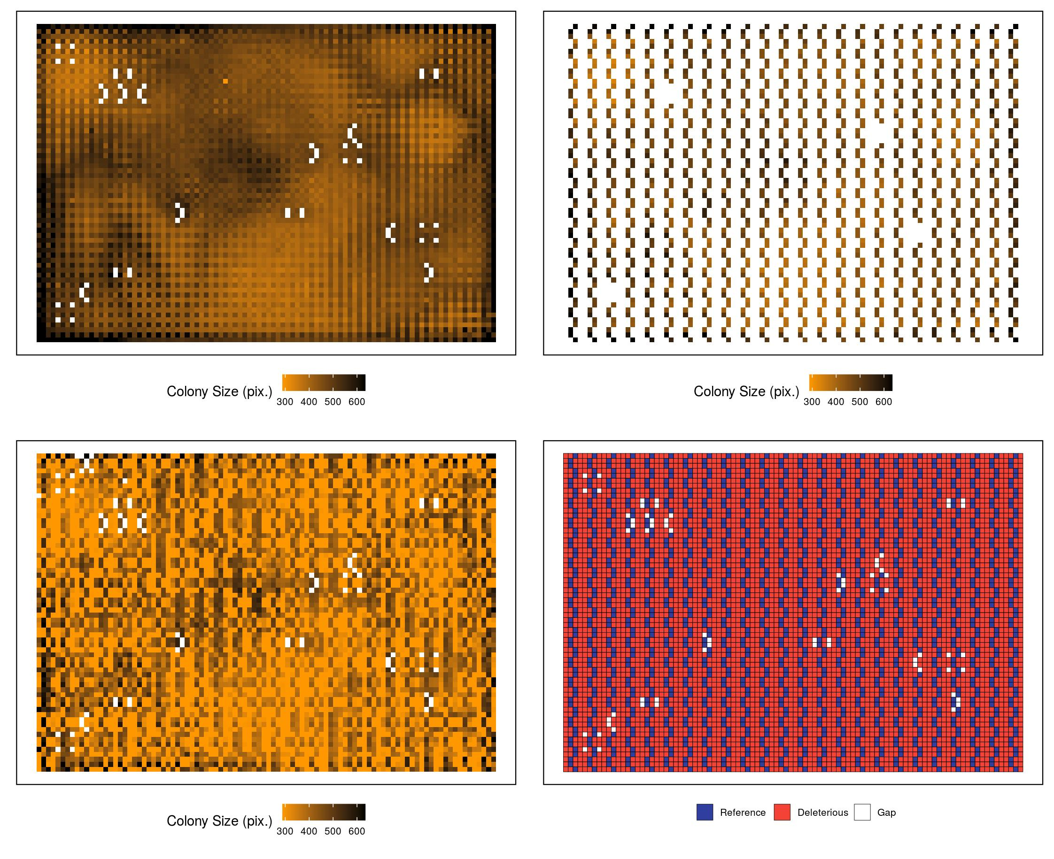
Virtual Plates with Random Colony Size Distribution
Time = 6.14 hours
Time = 11.04 hours

Slide 23
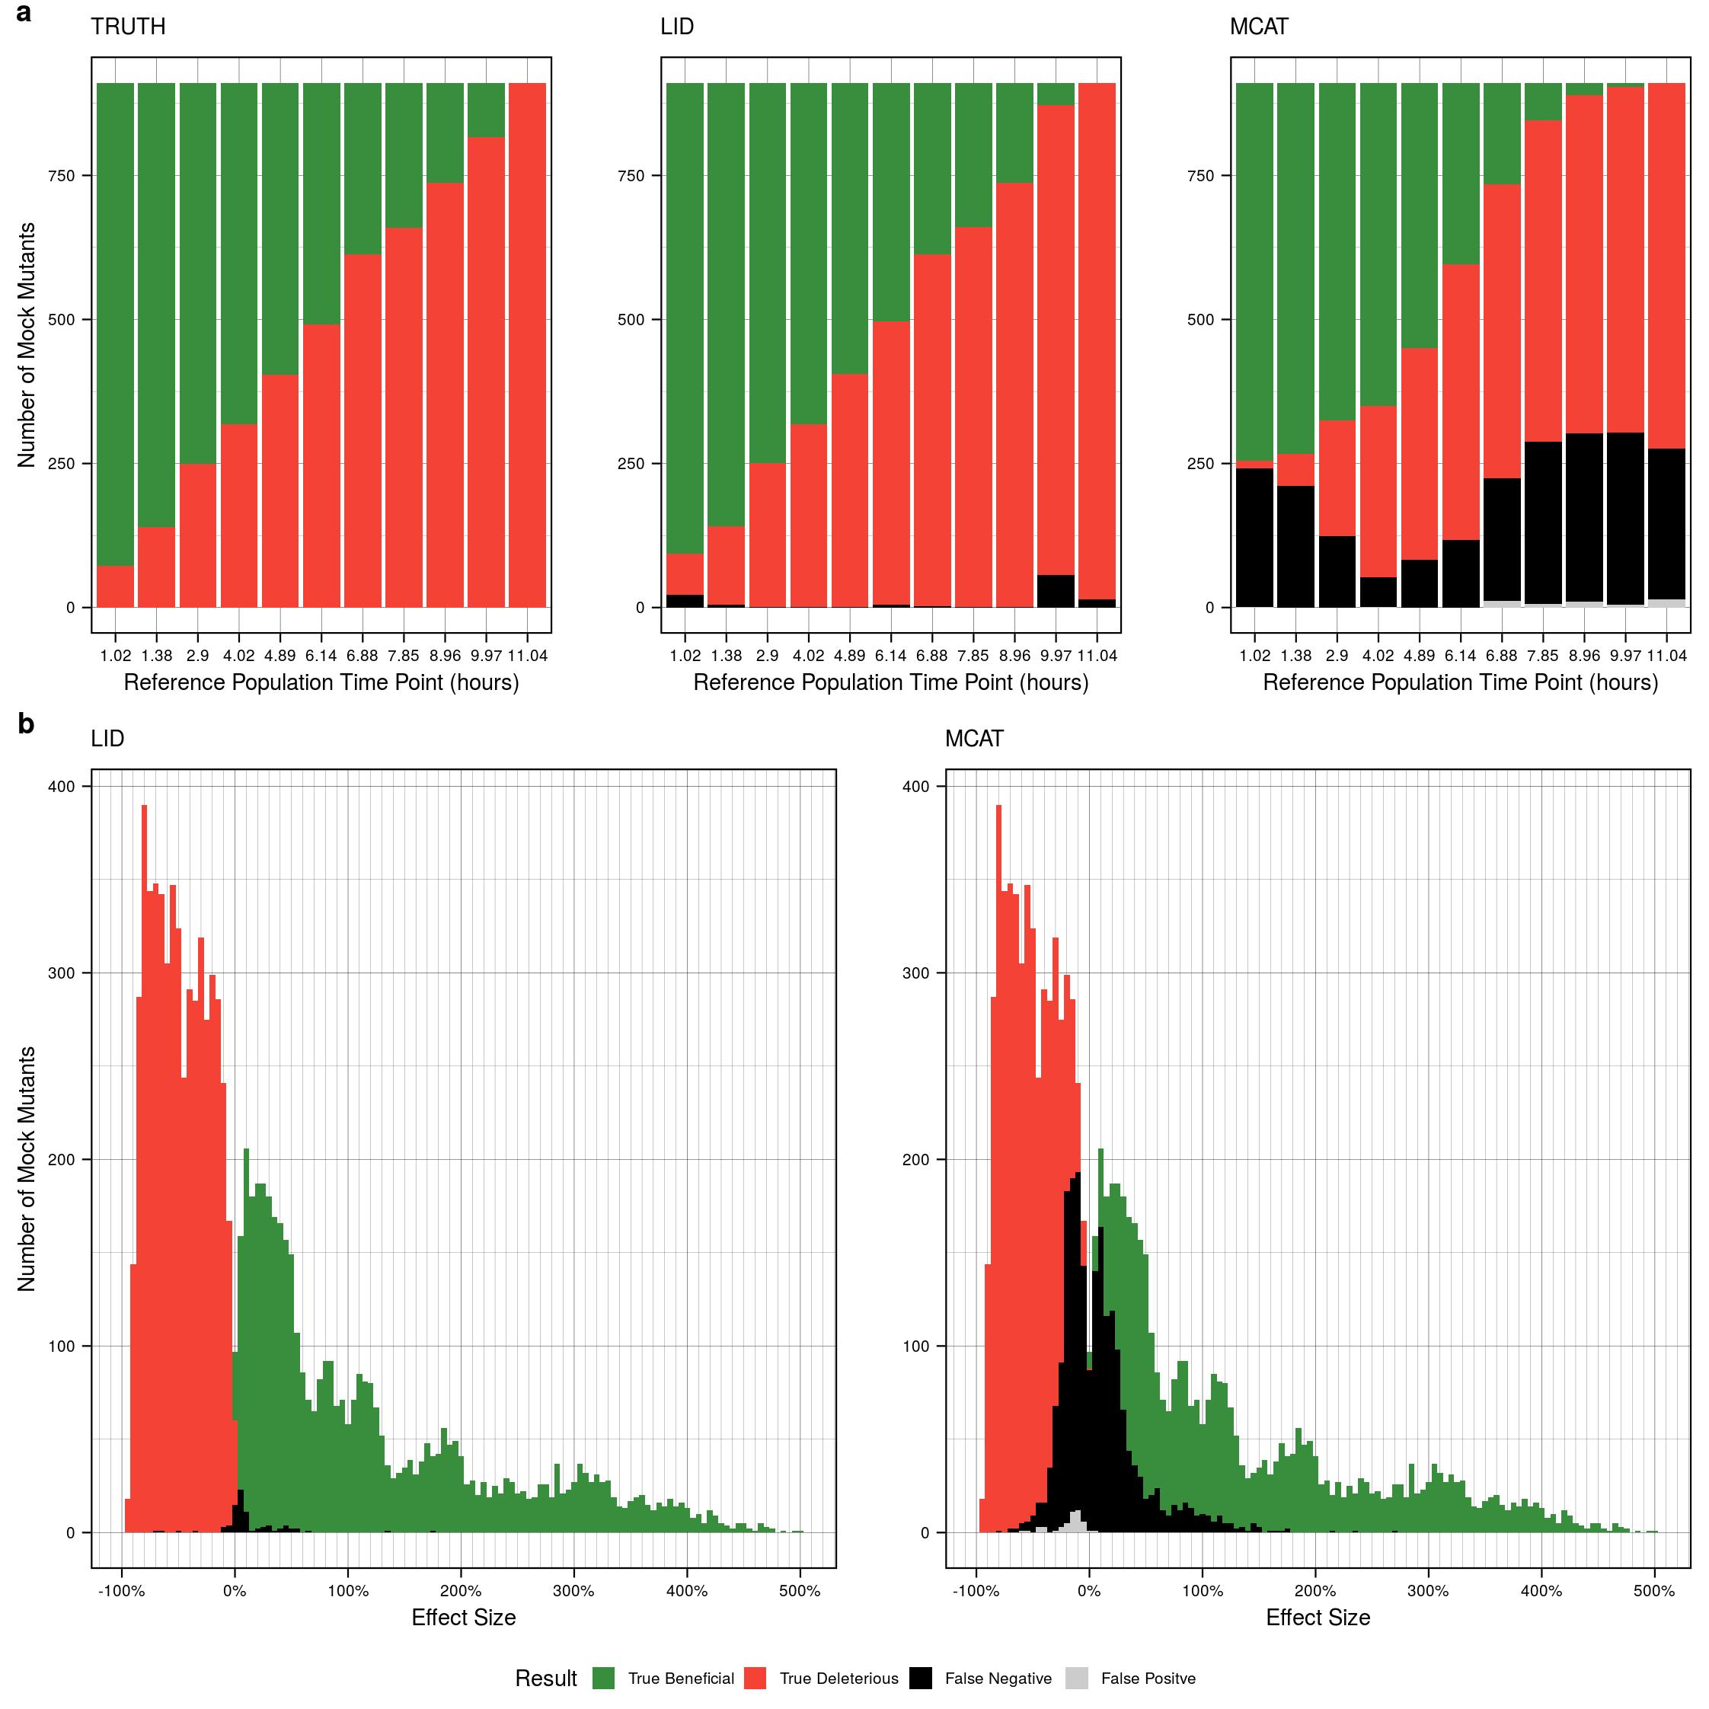
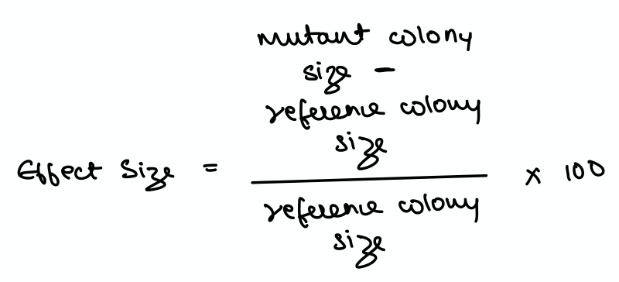
Results from Random Distribution
MCAT =
MATLAB Colony Analyzer Toolkit

Slide 24
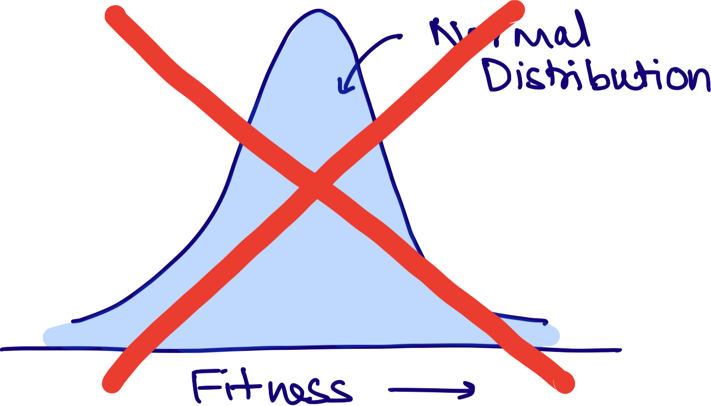

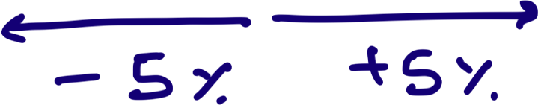

LI Detector improves upon existing methods
Notes:
4. Is able to detect fitness effects as low as 5% with 70% sensitivity and 95% specificity

Slide 25
LI Detector can expand the use of CBHTS
Although developed in yeast, it can be applied to all colony-forming-microorganisms

Slide 26
LI Detector can expand the use of CBHTS
Free of scale and assumptions of underlying fitness distribution
Screen a handful of mutants of your favorite gene (YFG), each having a specific residue of its active site mutated to see which position is most important
Genome-wide yeast-two-hybrid screen to figure out protein-protein interaction of YFG

Slide 27
LI Detector can expand the use of CBHTS
High sensitivity and specificity in observing small changes in fitness would provide reliable and highly resolved phenotypic data
Can be used to improve upon the existing gene-gene, gene-environment and protein-protein interaction networks

Slide 28
LI Detector can expand the use of CBHTS
It is equally sensitive towards detecting both decreases and increases in fitness
Screens that examine gain-of-function mutations
Pharmacological screens of drug/chemical resistance
Explore questions of evolutionary biology
Notes:
And explore questions of evolutionary biology, which was ultimately the motivation to go through this entire exercise.

Slide 29
Proto-genes & LI Detector
We have expanded the BarFLEX collection (Douglas et al., 2012) to include ~1800 proto-genes in total
Screen for their phenotypic impact in a variety of conditions using CBHTS & LI Detector
Notes:
So moving forward, we have already expanded the BarFlex collection to include ~1800 proto-genes
And the next step will be to screen for their phenotypic impact in a variety of conditions using CBHTS and the LI Detector

Slide 30
Summary
Background
Colony based high-throughput screens (CBHTS)
Problem of spatial bias in CBHTS
How does LI Detector address this issue?

Slide 31












Thank You All!
Questions?
@sauriiiin
This work was supported by: funds provided by the Searle Scholars Program to A-RC; the National Institute of General Medical Sciences of the National Institutes of Health grants R00GM108865 awarded to A-RC.
Notes:
Finally I would like to thank all the lab members who have helped me develop this method and to the organizers for giving me this opportunity to showcase my work in front of this community.
With that I would like to take your questions.
fitness vs reference over time for how that behaves over time
how dense the cells
faster growing reference - if you are loosign decriminationaibility
perfect position to be able to measure -

Slide 32
APPENDIX

